Slide 1
First Contact Practitioner/Advanced Practice Roadmap Supervision

Slide 2
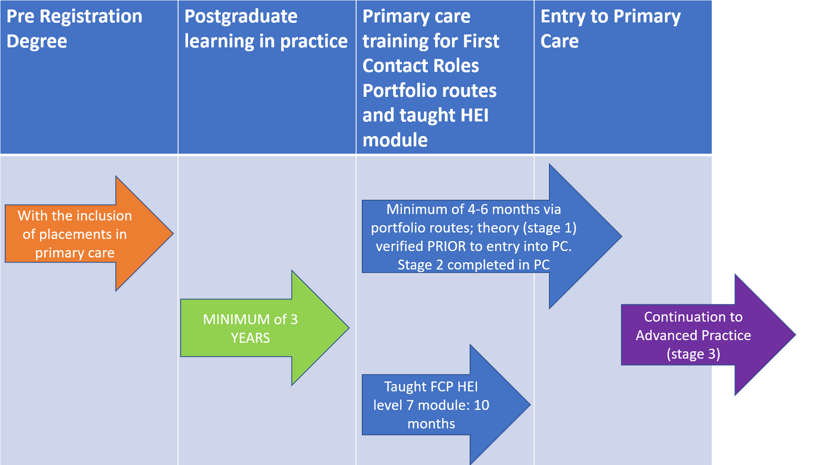


Slide 3
Key Points
These supervisors will be responsible for:
  Day to day clinical supervision within the clinical setting – debriefs – ensuring patient safety and practitioner safety
  Undertaking the workplace based assessments (WPBA) listed in the Roadmap, using the WPBA tools provided
  Verifying practice via review of portfolio of evidence against the Roadmap capabilities

Slide 4
Why?
Roadmap supervision – bespoke to the roadmap
Verifies triangulated evidence to a masters level
Supervisors are ACCOUNTABLE in a court of law
2 stages: 1. academic verification
2. verification of academic knowledge to practice using RCGP WBPA
A supervisor must have completed the 2 day Roadmap Supervision FCP-ACP Course to supervise FCP/Advanced Practitioners

Slide 5
Who can be a Roadmap Supervision trainer?
To be a trainer to run supervisor courses you need to be:
  A GP/GP Trainer/GP PD
  An AHP Consultant Practitioner
  An Advanced Practitioner holding a full Advanced Clinical Practice Masters Degree

Slide 6
Who can be a Roadmap Supervisor?
A GP/GP Trainer
An AHP Consultant Practitioner
An Advanced practitioner holding a full ACP Masters degree
If you hold a full post graduate Masters degree and work in the area of practice that you will be supervising
From April 1st 2021 all FCPs/Advanced practitioners who have been verified on the portfolio route, recognised by the HEE Centre for Advancing Practice and are on the Centre’s Directory

Slide 7
DAY 1
Welcome
Introductions – backgrounds, experience of supervision to date
National update re First Contact (FC) & Advanced Practice (AP)
What is FC & AP?
What is roadmap supervision in primary care?
CPD Supervision
Clinical Supervision
Educational culture/learning environment
Induction
Timetables/rotas
Introduction to some educational theory
The trainee/practitioner journey to FC or AP
Meeting the trainee/practitioners needs
Supervisor and supervisee well being
Feedback
Debriefing
The four pillars of advanced practice

Slide 8
DAY 2
Portfolios of evidence – contents & why
Professional Development Plans (PDP) - how to write a SMART PDP
Being a reflective practitioner
Overview of learning and teaching styles
Supporting trainees/practitioners in/with difficulty
Poorly performing trainees
Effective use of WPBA tools
Reflective learning logs
Consultation observation tool (COTs)
Case Based Discussion (CBD)
Clinical exam & procedural skills (CEPs)
Audit/QIP expectations (requirements for FC & AP)
Educational, leadership & management evidence for AP
Reviewing progression
Verification processes with Centre for
Advancing Practice

Slide 9
The Ask
Regions | No AHPs AHP’s identified from workforce returns 2021 | Number of Trainers to be identified per STP | Number of supervision courses required to enable roadmap supervision per STP footprint (14 per cohort) | Cost per region
NW | 269 | 8 | 20 | £16,000
NE | 313 | 10 | 22 | £17,600
CENTRAL | 395 | 22 | 28 | £22,400
EAST | 255 | 12 | 18 | £14,400
LONDON | 310 | 8 | 22 | £17,600
SE | 270 | 12 | 19 | £15,200
SW | 201 | 14 | 14 | £11,200
National total cost |  |  |  | £114,400 + £16,000 paramedics = £130,400

Slide 10
Next steps
Following on from the scoping work - Regions to identify the number of Roadmap Supervision Trainers needed across the STP footprint with the required qualifications and send the names and contact emails to HEE by the end of December 2020 to be trained in February 2021
STP footprint to work with Trained Roadmap Supervision Trainers to agree dates across the Region to deliver the required number of Roadmap supervision courses to equip the region with the required supervisor numbers to begin in March 2021

Slide 11
Thank you

