Slide 1
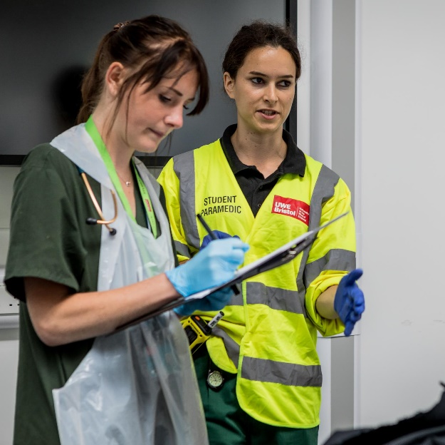
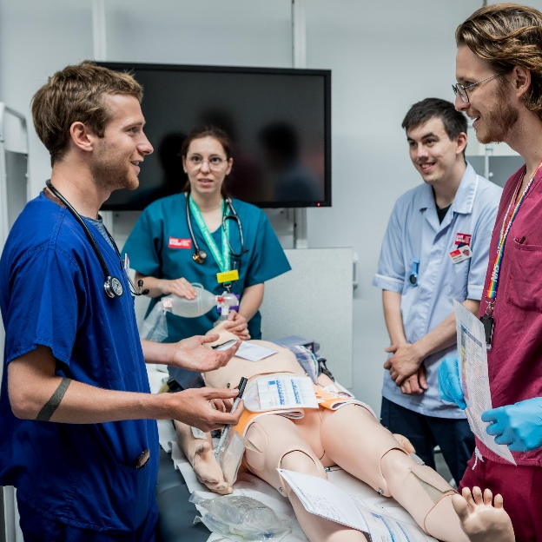
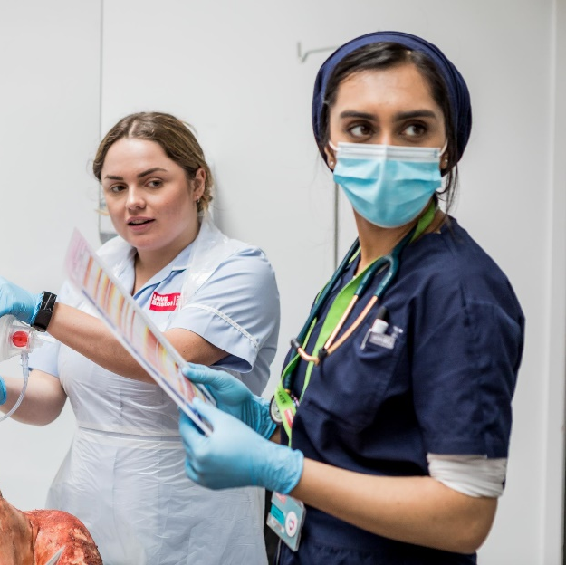
MSc Physician Associate Studies
Placement Supervisors & Practice Educators Briefing
Updated 2023
Notes:
Welcome to the placement supervisor and practice educator briefing for the Physician Associate studies programme at the University of the West of England.
We would like to start by thanking you for supporting Physician Associate students on their practice placements.
Similarly to other healthcare students, Physician Associates in training must complete a minimum of 1600 hours of clinical practice in order to qualify and be eligible to undertake the national registration examination.
Your role as either a placement supervisor, or as a practice educator, is vital to the process and the PA programme team are here to support you.
We define placement supervisors as being the named individuals who are responsible for the student whilst they are on placement, whilst practice educators may have a secondary role in assisting in the students learning and development whilst they are on placement.
Both placement supervisors and practice educators are vital to a successful Physician Associate placement experience.

Slide 2
Aims of the briefing
To understand the structure and process of UWE Physician Associate placements
To understand the role and responsibilities of the UWE Physician Associate Placement Supervisor (Practice Educator)
To understand the assessment and feedback methodology used for PA placements
To know how to access support and training
Notes:
This presentation aims to take you through the key information and responsibilities you need in order to support your students, and also where to find additional support and guidance.
More specifically the aims of this presentation are:
To help you understand the structure and Process of UWE Physician Associate placements:
To understand the role and responsibilities of the UWE Physician Associate Placement Supervisor (Practice Educator)
To understand the assessment and feedback methodology used for PA placements
To know how to access support and training

Slide 3
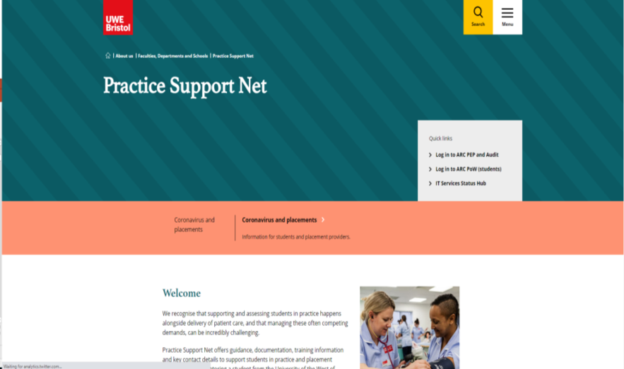
Lots of information…
Just google 'UWE
Practice Support
Net'
The UWE Practice Support Net is there to help and can be accessed using this link or Google
Follow ‘Programme Guidance' to get to the Physician Associate Programme information (or click here).
Please be aware we update PSN as the academic year progresses so please make sure you check on a regular basis.
Notes:
You may new to hosting Physician Associate students, or you may be experienced. We may have worked with you before, or this may be your first time working with the university.
Either way our online resource Practice Support Net is here to help you.
It contains the latest up to date information and documents you will need, including this presentation.
You can access Practice Support Net via the hyperlink in this presentation or you can google ‘UWE Practice Support Net Physician Associate’
You’ll be able to access the page immediately as it does not require a log in.
The site contains all the information you would need prior to and during the placement, including contact details, placement learning outcomes and other placement documentation.
Please be aware that we update Practice Support Net throughout the academic year, so please ensure you are checking regularly for the latest updates.

Slide 4
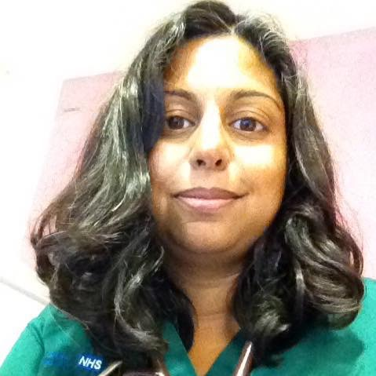
Physician Associate Who's who?
Dr Lara Menon
Programme Lead and Secondary Care Placement Lead
Lara.Menon@uwe.ac.uk
James (‘Jim’) Willis
Senior Lecturer and Primary Care Placement Lead
James5.Willis@uwe.ac.uk
Georgina Everett
Programme Placement Coordinator
ppoallocations@uwe.ac.uk
Notes:
Our placements are a partnership between the students, their placement providers, and the University of the West of England.
In addition to Practice Support Net, we at the university on the programme team are here to help and support you.
Dr Lara Menon is the programme leader for the Physician Associate Studies Masters, and is our lead for secondary care placements. She is pictured at the top right of the slide.
My name is Jim Willis and I am a senior lecturer and primary care placement lead on the programme, and I am pictured in the middle of the slide.
Georgina Everett is the programme placement coordinator
If you have any questions or queries with regards to the PA programme and placements, please do get in touch with us via email.
To help with responding to your query, it is best practice to send your query to the appropriate individual based on their role.
For example, if you are a GP practice with a query, you can email myself and Georgina.
If you are a hospital-based placement please email Lara and Georgina.
For general administrative queries please email Georgina.

Slide 5
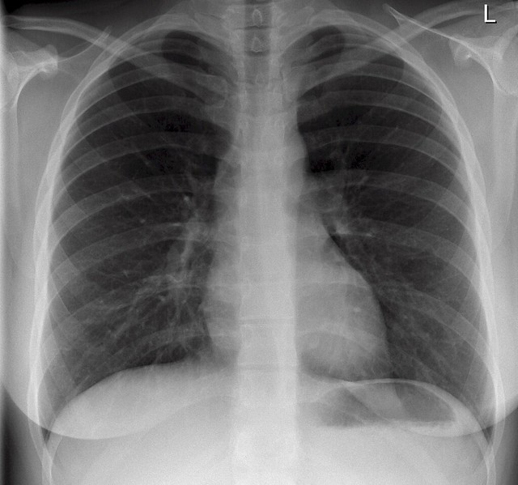
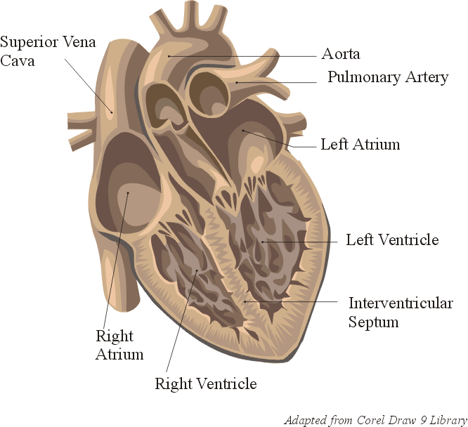
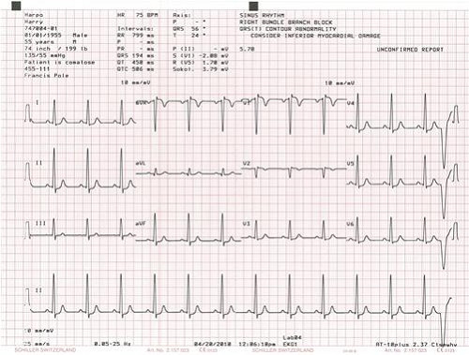
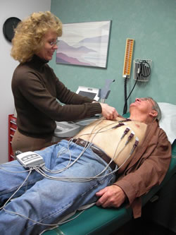
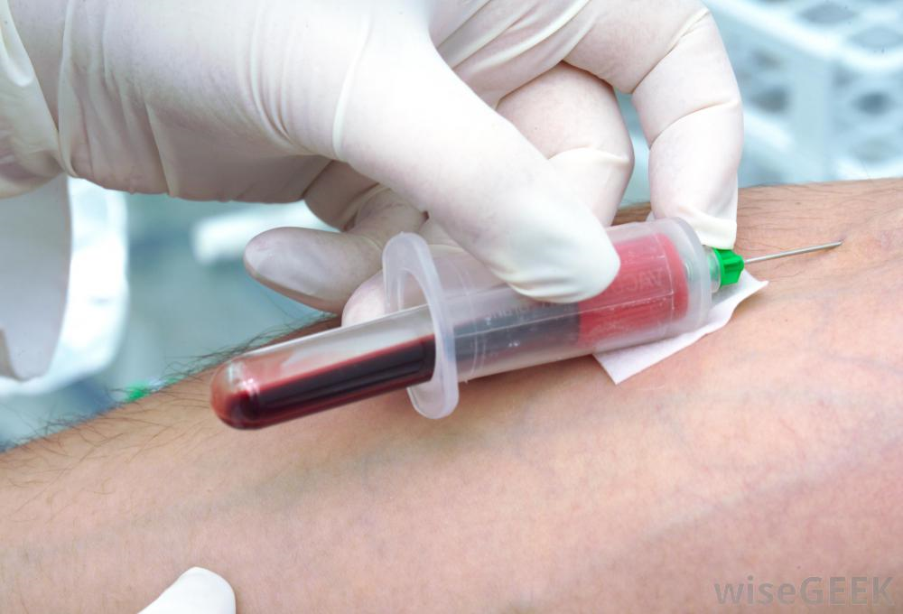
Helical Learning Example
Symptom
History & Clinical Signs
Normal Anatomy
Diagnostics
Clinical Reasoning
Normal Physiology
Cardiovascular Examination Skills
Pathophysiology
Pathophysiology
Data Interpretation
Differential Diagnosis
Pharmacology
Specialised Skills ECG
Microbiology
Communication Skills
Applied Clinical Medicine
Therapeutics
Specialised Skills - Venesection
Notes:
So what does the programme look like?
The PA programme is a full-time, two year Masters-level programme of learning.
The programme is designed based on a spiral curriculum whereby content is revisited and further developed in each pass.
Let’s take cardiovascular medicine as an example.
Students will begin by being exposed to a symptom, such as chest pain, before being presented with a simulated patient case including a clinical history and relevant clinical signs.
They will then undertake learning in the normal anatomy relevant to this system, for example the heart, the coronary arteries and great vessels before moving onto the relevant pathophysiology and infectious microbiology relevant to this system.
In the first pass covering this system, students will learn the core essential examination skills needed – for example the cardiovascular system exam. In the second and third passes they will cover more specialised skills relevant to the system, such as ECG recording and venesection.
Students are then expected to use their learning to begin to develop their clinical reasoning skills in order to construct a differential diagnosis which they can test with further learning in applied clinical medicine.
Ultimately students will move forwards to identifying a focussed list of differential diagnoses, and will examine the pharmacological and therapeutical approaches to managing these conditions before discussing routine and advanced diagnostics and data skills.
Students conclude their helical learning by practicing drawing all of their experiences together by conducting a mock consultation with a patient, where they are able to hone their communication skills in explaining a diagnosis and its associated management to a simulated patient.

Slide 6
MSc Physician Associate Studies
2 Years FULL TIME
1st Year: Students cover the fundamental medical specialties e.g. cardio, resp, neuro, gastro.
2nd Year: Students cover additional specialties e.g. emergency medicine, surgery, paediatrics, mental health, obstetrics & gynaecology.
Placements Overview (from August 2023)
Y1 Primary Care: | Y1 Secondary Care: | Y2 Primary Care: | Y2 Secondary Care:
Block 1: 3 Weeks | Block 1: 3 Weeks | Block 4: 3 Weeks | Block 4: 10/11 Weeks
Block 2: 3 Weeks | Block 2: 3 Weeks |  | Block 5: 7 Weeks
Block 3: 3 Weeks |  |  | Block 6: 3 Weeks
 |  |  | Block 7: 7 Weeks
Notes:
In the first year of their studies, the students primarily focus on the fundamental medical specialties including (but not limited to) cardiology, respiratory, neurology and gastroenterology.
In the second year of the programme, the students focus on specialties intended to further develop their practice and competence, including emergency medicine, general surgery, obstetrics and gynaecology, paediatrics and mental health.
Please note that as part of the ongoing programme restructuring, students starting in august 2023 will cover mental health in the first year of their studies, whilst students transitioning to the second year of the programme in august 2023 will cover mental health in their second year.
In addition, the students undertake multiple placement blocks distributed across their first and second year, in both primary and secondary care, as illustrated in the table in the slide above.
This ensures a range of experience in different clinical areas, culminating in having achieved 1600 hours in practice.

Slide 7
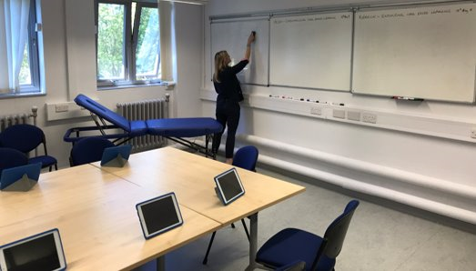
Two Year Programme - Modules
Year 1
Term 1
Term 2
Term 3
Foundations in Clinical Medicine I & Foundations of Physician Associate Practice I
Research Methods
Interprofessional Communication in Practice
Year 2
Term 1
Term 2
Term 3
Foundations in Clinical Medicine II & Foundations of Physician Associate Practice II
Interprofessional Communication in Practice
PA Learning in Practice
Notes:
This slide provides an overview of the modular structure of the MSc Physician Associate studies programme.
In the programme’s current structure, students undertake a total of 180 credits split across their two year programme.
Students must achieve the total of 180 credits to graduate with a masters degree.
I will go on to explain these modules shortly, but please be aware that the programme structure may change in lieu of the GMC becoming the legal regulatory body for Physician Associates.
Communications around any programme structure changes will be released as and when these have been confirmed.

Slide 8
Two Year Programme – Y1 Modules
Year 1
Term 1
Term 2
Term 3
Foundations in Clinical Medicine 1 (30 Credits):
100 Question SBA & Viva Presentation
Foundations of Physician Associate Practice 1 (30 Credits):
10-station OSCE
Research Methods (15 Credits):
3000-word research/project proposal
Interprofessional Communication in Practice (15 Credits):
Placement Portfolio
Notes:
Shown in the slide are the modules the students undertake in the first year of the programme.
Foundations in Clinical Medicine I focusses on the theoretical content which underpins clinical practice, and is assessed with a viva presentation of a patient case, typically at the module mid-point, and with a 100 question single best answer exam, typically near the module’s conclusion.
Foundations in Physician Associate Practice I focusses on the examination skills and practical competencies needed for undertaking clinical work, and is assessed with a 10-station OSCE circuit at the end of the module.
Research Methods is a 15-credit module which introduces students to healthcare research methodology, and is assessed with a 3000-word written research proposal.
Interprofessional Communication in Practice is a 15-credit module which continues into the second year of study. This module focusses on PAs working as part of a team, and incorporates high-fidelity simulation events where PA students work alongside other healthcare students at Glenside campus including nurses and paramedics. Additionally, this module is assessed with the student PA practice portfolio, which includes their placement-based assessments they will be completing with yourselves.

Slide 9
Two Year Programme – Y2 Modules
Year 2
Term 1
Term 2
Term 3
Foundations in Clinical Medicine 2 (30 Credits):
100 Question SBA & Viva Presentation
Foundations of Physician Associate Practice 2 (30 Credits):
10-station OSCE
Interprofessional Communication in Practice
(15 Credits): Placement Portfolio
PA Learning in Practice (30 Credits):
5000 word final project/dissertation
Notes:
Moving onto the second year of the programme,
Foundations in Clinical Medicine 2 builds upon the theoretical content from year 1, and is assessed with a viva presentation of a patient case, typically at the module mid-point, and with a 100 question single best answer exam, typically near the module’s conclusion.
Foundations in Physician Associate Practice 2 focusses on the more advanced and specialty specific examination skills and practical competencies needed for undertaking specialty-based clinical work, and is assessed with a 10-station OSCE circuit at the end of the module.
PA Learning in Practice is a 30-credit module in which students compile a 5000 word portfolio, which can either take the form of research (such as a systematic literature review), or a as a clinically focussed project (such as a QiP, audit, business case, or project report).

Slide 10
Placement Hours and Study
Full time although there can be variation to how this is arranged
Normal expectation is 7.5 hour working day (e.g. 08:30-17:00) –but this can also include shift patterns
Students are not expected to work weekends – but can do if the opportunity is available
Sickness /Absence Reporting – follow placement & UWE policy
Timesheets hosted on ARC
Notes:
Students are expected to undertake full-time hours whilst on their clinical placements, though how this is arranged can be negotiated between the placement and the student to ensure an optimal learning experience is provided.
For example, the normal expectation is that students will work a 7.5 hour day for 5 days per week, typically this might be from 8:30AM to 5:30PM.
However, students are also welcome to work shift patterns, or to work their hours in a consolidated pattern, such as three or four longer days.
Whilst there is no expectation of them to do so, they are also welcome to work weekends if this can be accommodated by the placement provider.
The caveat to this is that the student must always have a clinical supervisor present when they are on-shift, and so we encourage placement providers to consider this when planning rotas for PA students.
In the event of absence, students should follow both the university’s absence reporting procedure, and that of their placement provider.
PA students use digital timesheets which are hosted on the university’s ‘ARC’ platform. The clinical supervisor should provide the student with their email address. The student will then email a link to ARC enabling their supervisor to ‘sign-off’ on their hours accrued.

Slide 11
Placement Professionalism and Probity
Key UWE Policies:
Student Conduct Policy
Professional Suitability Policy and Procedure
Student Behaviour and Health Policy Framework
UWE Policies can be found at: https://www.uwe.ac.uk/about/structure-and-governance/policies
Key FPA& GMC Policies:
Code of Conduct for PAs
Good Medical Practice for PAs (& AAs)
Fitness to Practice for PAs (& AAs)
Notes:
Students are expected to adhere to the Universities’ policies, and those of the Faculty of Physician Associates and the General Medical Council (GMC).
Students are introduced to these policies upon commencing their studies in the first year of the programme and are periodically re-introduced to these policies throughout the two-year course.
In addition, during the first year of the programme, students undertake weekly teaching and learning on the role of a PA as a professional and are expected to discuss this with their academic personal tutors throughout their time with us at the university.
PAs are expected to follow the standards set out in the GMC’s ‘Good Medical Practice’ guidance. This includes the professional and ethical knowledge, skills and behaviours expected when working in the UK. The GMC have published an interim version of the guidance ahead of the start of regulation .

Slide 12
Placement Process
Placement coordinator secures placement providers and allocates students
UWE monitors allocation for quality assurance and to ensure it meets the required standards.
Students should contact the placement to initiate relationship and gather information
Student starts the placement
Student and supervisor mutually agree dates and times for initial meeting and end of placement review
Student undertakes placement, and completes the work/placement-based assessments (WPBAs)
Student and supervisor meet for end of unit/end of placement review
Supervisor completes written end of unit/end of placement review (student inserts into portfolio)
Supervisor signs off timesheets on ARC (if not already done so)
Notes:
This slide provides you with an overview of the placement process.
Placements are secured by the placement coordinator, who then allocates the students to their placements.
The university monitors placements for quality assurance, to ensure that the placements also meet the required standard, and to ensure that the student is gaining an appropriate breadth of placement experiences.
Once a placement is allocated we encourage all students to take responsibility for initiating contact and forging relationships with their placement supervisors and practice educators to gather information and discuss the details of the placement. This may be a telephone call or an email.
We encourage our students to find out if there is any reading that would be helpful to complete prior to the placement and practical details such as where they should go and who they will meet on their first day.
The student will then start the placement and should mutually agree with their supervisor dates and times for an initial meeting (in which goals can be set, and time for assessments mapped out), and for their end of unit/end of placement review.
The student will work towards completing their placement based assessments (found within their practice portfolio) during the placement. It is not the responsibility of the placement supervisor/practice educator to chase the student for their portfolio. Rather, the student should be proactive and seek opportunities to complete their allocated portfolio tasks.
In the event that the student has not provided you with good oversight of their portfolio, or you have concerns about them failing to complete their placement based assessments, please contact the programme team at the earliest opportunity via the email: pastudies@uwe.ac.uk
The placement concludes with a final review meeting, completion of the end of unit/end of placement report, and sign-off of the students timesheets.

Slide 13
Notes:
These are some of the qualities that a successful placement supervisor, or practice educator, need in order to support a successful placement for the student.
Our students appreciate placement supervisors who are organised, professional, knowledgeable, available and communicative.
Good assessment outcomes occur when the practice educator is constructive, realistic, and objective.
Our students feel inspired when their placement supervisors are self-confident, motivated, and dynamic.
Now that we’ve looked at the qualities of the placement supervisor/practice educator, we’re now going to move onto your responsibilities.

Slide 14
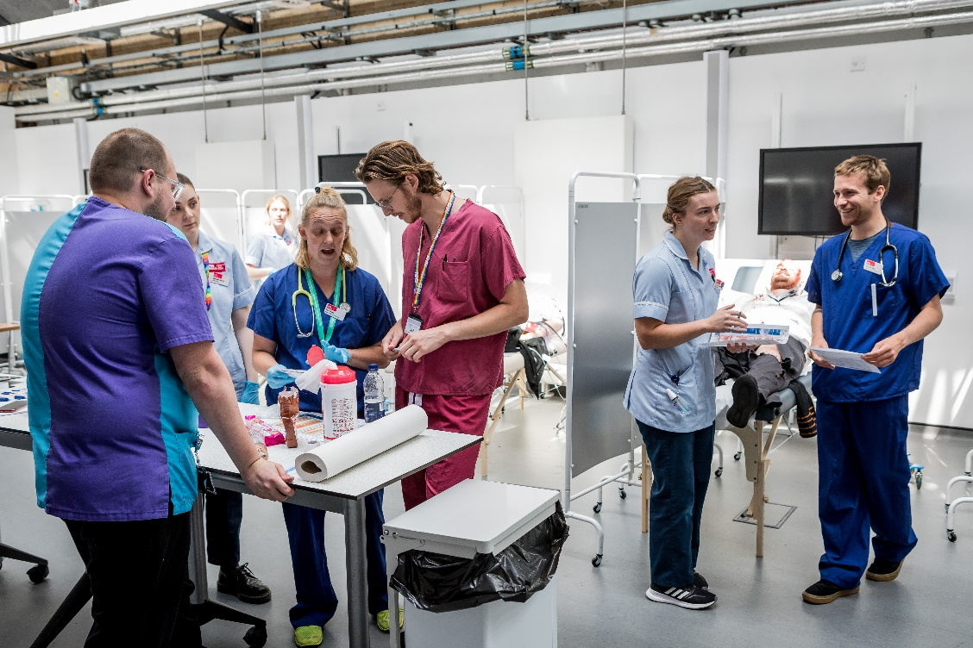
Placement Supervisor Responsibilities
Understand the learning outcomes (placement competencies)
Understand the student’s needs / experience / motivations
Induct the student to the placement setting
Monitor, facilitate and guide learning opportunities
Provide regular weekly supervision
Support the student in completing their placement based learning events (PLEs)
Continually assess and provide feedback to the apprentice
Participate in an end of unit/end of placement review
Sign off students’ timesheets on ARC
Inform the UWE team of any concerns as soon as possible
Notes:
Prior to the placement, it is a good idea to gain an understanding of the placement learning outcomes and consider how they could be met in your clinical setting (these can be found on practice support net).
Do also take some time to understand the student, considering their needs, experience and motivations.
Do provide the student with an induction to your placement setting. You could consider using your local induction processes, or creating a bespoke document to support this.
You may want to include orientation to the building, an introduction to the clinical team, use of telephone systems and digital resources, and restroom locations.
You may also want to discuss absence reporting procedures, and how best for the student to contact their placement supervisor and practice educators.
Other responsibilities include monitoring, facilitating and guiding learning opportunities, and supporting students through their placement experience by continually assessing and providing feedback.
We will come on to discuss this later in this presentation, but in the event that you have concerns about a student you have the responsibility to contact the programme team at the earliest possible opportunity.
And of course, don’t forget to complete the end of unit/end of placement review and to sign off the students’ timesheets.

Slide 15
The Placement Competencies
Each of the placements which PA students undertake have a distinct set of learning outcomes that the student must evidence in order to complete the placement (and pass their portfolio) assignment.
These are available to view on the Practice Support Net: click here
Check which placement your student is completing and ensure you familiarise yourself with the relevant placement learning outcomes. Think about how these can be addressed in your setting.
The placement learning outcomes are written in such a way that they interlink into each other.
Each placement builds on the knowledge, skills, and behaviours of the last placement.
Notes:
You may have started to think about the placement coming up and be asking the question ‘how can I ensure that a student experiences the most from my setting?’, ‘what do they need to learn?’ and ‘what opportunities are there in this setting?’
The placement learning outcomes (found on Practice Support Net) are there to support you in considering the learning opportunities available in your department/setting.
Each placement rotation has a distinct set of placement learning outcomes that the student must evidence progress towards in order to complete the placement (and therefore pass their practice portfolio).
Please ensure you familiarise yourself with the learning outcomes relevant to your department/setting.
The learning outcomes are written in such a way that they interlink and build upon each other, enabling the student to continue their learning and develop their practice as they move from placement to placement.

Slide 16
Access to Placement Plans
Students are encouraged to discuss these with their placement supervisor
Reasonable adjustments may be needed to support student learning in practice
Students with specific disabilities may require general adjustments
Students with specific learning disabilities may require general adjustments
Useful guidance can be found here: UWE Disability Support Services
Notes:
Some of you may be supporting students with additional needs, who may have an access plan detailing recommendations for reasonable adjustments.
Students are encouraged to share this with you at the beginning of the placement so that reasonable adjustments can be discussed and implemented.
Please do ask the student if they have any access or support needs at your initial meeting as this will support them in learning how to manage their needs in a professional setting.
If the student choses not to disclose, there is no expectation on you to implement reasonable adjustments.
Some students with additional learning needs, such as dyslexia, may not have a personalised access plan, but will be expected to discuss general reasonable adjustments that will support them in practice.

Slide 17
Key Assessments used on Placement
Mini-CEX:
Case-Based Discussion
Direct Observation of a Procedural Skill (DOPS)
Clinician directly observes student clinical encounter with a patient to provide an indication of competence in skills essential for good clinical care such as history taking, examination and clinical reasoning.
Clinician assesses student performance by reviewing a written record and verbal presentation of a patient encounter to provide an indication of competence in areas such as clinical reasoning, decision-making and application of medical knowledge.
Clinician evaluates the performance of a student in undertaking a practical procedure. The trainee should receive immediate feedback to identify strengths and areas for development.
Notes:
It’s now time to discuss the types of work/placement-based assessments our students must undertake whilst on their clinical rotations.
Work/placement-based assessments provide a structure for observing the individualised and contextualised application of learning. By providing feedback and encouraging reflection it also helps trainees develop self-regulated learning skills.
Mini-CEX: This tool evaluates a clinical encounter with a patient to provide an indication of competence in skills essential for good clinical care such as history taking, examination and clinical reasoning. The student receives immediate feedback to aid learning. The mini-CEX can be used at any time and in any setting when there is a trainee and patient interaction and an assessor is available.
Case-Based Discussion: The CbD assesses the performance of a trainee in their management of a patient to provide an indication of competence in areas such as clinical reasoning, decision-making and application of medical knowledge in relation to patient care. It also serves as a method to document conversations about, and presentations of, cases by trainees. The CbD should focus on a written record (such as written case notes, out-patient letter, discharge summary).
Direct Observation of a Procedural Skill (DOPS): A DOPS is an assessment tool designed to evaluate the performance of a trainee in undertaking a practical procedure, against expected standards for clinical practice. The trainee receives immediate feedback to identify strengths and areas for development.

Slide 18
Key Assessments used on Placement
Multisource Feedback (MSF)
Patient Questionnaires
Can be completed by individuals who the student has worked with such as clinicians, administrative staff, and other allied professionals. Students are assessed on skills such as communication, leadership, team working, reliability etc, across the domains of Good Medical Practice.
Completed by patients the student has seen. Students are assessed on their professional behaviour and the effectiveness of the consultation, it is intended to assess the trainee’s performance in areas such as interpersonal skills, communication skills and professionalism.
Notes:
Multisource feedback: This tool is a method of assessing skills such as communication, leadership, team working, reliability etc, across the domains of Good Medical Practice. This provides systematic collection and feedback of performance data on a student, derived from a number of colleagues. ‘Raters’ are individuals with whom the student works, and includes doctors, administrative staff, and other allied professionals. Students collate their multisource feedback in their portfolio.
Patient Questionnaires: The PQ addresses issues, including the behaviour of the student and effectiveness of the consultation, which are important to patients. It is intended to assess the trainee’s performance in areas such as interpersonal skills, communication skills and professionalism by concentrating solely on their performance during one consultation.

Slide 19
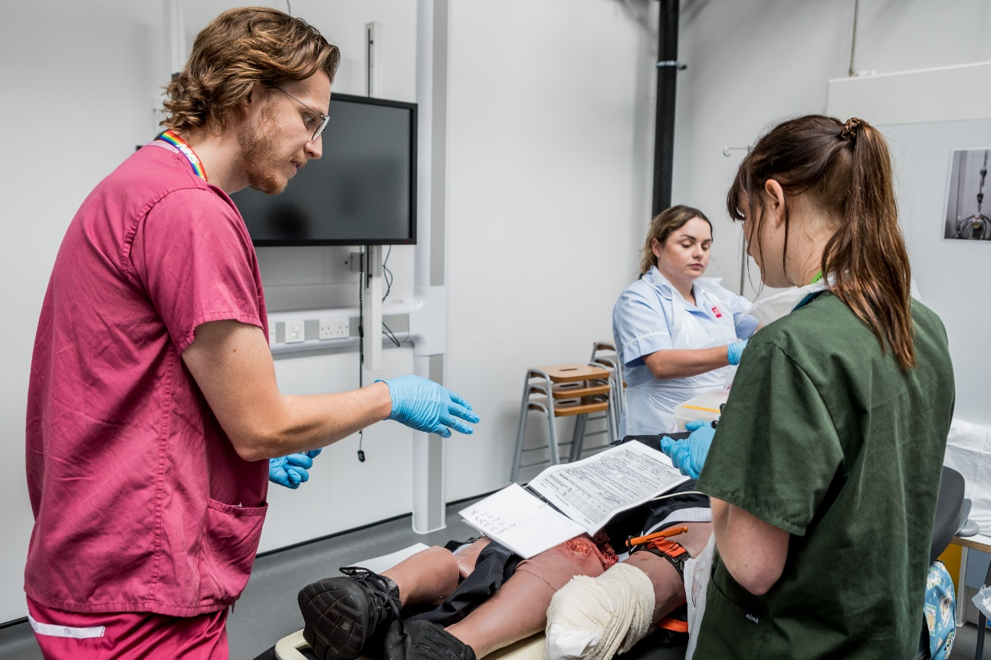
Considerations…
Assessments are led by the student but guided by you
How will the student be allocated time on the placement to complete their assessments?
Are you comfortable with all aspects especially the criteria for- evaluation?
Notes:
It is worth just taking a moment to recognise the important considerations when evaluating students.
Students should proactively take the lead in their assessments, but your role is significant – you are able to shape their development and influence their future practice.
We strongly encourage you to consider how time will be allocated for the student to complete their assessments whilst on placement with you, so that they are able to effectively manage their workload whilst on their clinical placement.
You need to be confident that you can determine whether or not the student is at the required standard based upon the learning outcomes relevant to your department/setting.

Slide 20
Find out about the student
Should be protected time
Experience
Preferred learning styles
Personal goals
Access Needs
Any issues that may impact on their performance?
Ask them what they expect from you
Supervision
Be clear about what you expect from them
Notes:
Whilst on placement, each of the students should be offered protected time to meet for supervision and completion of their placement based assessments.
It may be helpful in the initial meeting with the student to spend some time finding out about them.
You may want to ask them about their experience, their preferred learning styles, their personal goals, access needs and any other issues that might impact their performance on the placements.
It is also helpful to gain an understanding of what the apprentice expects from you and also the be clear about what you expect from them.

Slide 21
Observation
Direct Supervision
Indirect Supervision
Notes:
We are often asked about what the day-to-day role of a student PA on placement should look like.
This is of course dependent on the area/department within which the student PA is completing their placement, and as a programme team we try not to be prescriptive about the specifics of a PAs daily routine.
However, as a general rule of thumb, placements should typically begin with the student PA undertaking more observational tasks.
In primary care this may mean having students sit in on a morning or afternoon session observing a clinician’s surgery.
In secondary care this may mean having the students join a ward round or sit in on a specialist clinic.
Students should then be allowed to progress to performing tasks under direct supervision, including taking histories, examining patients, and performing procedures.
Regardless of setting, we would then expect by the end of the placement that the student would be performing those tasks whilst being ‘indirectly supervised’ – that is where a supervisor is readily available and within close proximity to provide support; or where a supervisor will be available to provide guidance, but will not directly oversee the tasks being undertaken.

Slide 22
Content
Reflection Teaching Support Goal setting Feedback Assessment
Notes:
Future supervision sessions could include the following:
There might be opportunity for reflection where you ask the student to consider their progress so far or reflect on particular aspects of work they’ve completed.
You may have identified or been asked by the student for teaching on specific topics to offer support to your student.
Do use your supervisory time to set some smaller goals with the student, in line with their learning outcomes.
Supervision is an opportunity to provide feedback. It is really important that the student has a sense of how they are progressing and where they need to improve.
It is also an opportunity to complete assessments and review the learning outcomes.

Slide 23
Models of Supervision
Consistent:
Communication
Expectations
Regular
Clear:
Responsibilities
Roles
Notes:
Supervision can take many different forms depending on the placement.
It may be one student to one supervisor, or two students to one practice educator, or alternative formats which you may decide to employ.
It is important that supervision is consistent. If there are two practice educators please ensure that you are both communicating the same expectations and feedback.
Do ensure that supervision is given on a regular basis, and that both you and the student are clear on your roles and responsibilities.

Slide 24
Assessment and feedback
Use your professional judgment and feedback from colleagues
Seek feedback from
patients
Give regular
encouragement
Provide constructive criticism
Set clear goals and expectations – check for understanding
Identify strengths
Use the Reporting Concerns process where appropriate
Notes:
When evaluating the student, you will be using your own professional judgement, feedback from colleagues, and also feedback from patients.
Do ensure that you give regular encouragement to the student to enable them to gain a sense of how they are performing during the placement.
Identify their strengths and also provide constructive criticism so that they are clear on areas where they might need to improve.
Check with the student that they understand both your meaning and your expectations.
You may notice at any point in the placement that a student is struggling. If you do please refer to the ‘Reporting Concerns’ process which is found on Practice Support Net, and contact the programme team as soon as possible.
At this point we really want to re-enforce the importance of timely and collaboratively feedback for our students, particularly those who you may have concerns about or who may be failing whilst on placement. It is far better for the student to be informed of this feedback as soon as is possible, rather than delaying it unnecessarily.

Slide 25
Supporting Struggling Students
Read the Reporting Concerns process on the Practice Support Net: Click here
Do articulate to the student clearly why (in your judgement) they are struggling so they are fully aware of the situation and need for action
Be clear about what your concerns are in relation to the placement learning outcomes and assessments
Ensure you have discussed with the programme team any yellow ‘Notification of Concern’ forms you intend to submit – either face-to- face or by digital means (e.g. zoom/teams)
Contact the programme team at the earliest signs to discuss potential action plans: pastudies@uwe.ac.uk
Provide plenty of guidance and opportunity for the student to address your concerns
Stay in regular contact with the programme team to discuss the student’s progress
Be open, supportive and give plenty of feedback and praise
Notes:
From time-to-time staff including clinical staff, academic staff, support staff and administrative staff may have concerns about individual students.
Concerns may vary in nature - from students who become withdrawn and about whom a member of staff is worried, to students whose attitude or behaviour is inappropriate.
Placement supervisors and practice educators should contact the programme team as soon as is possible to inform them of concerns, and complete a yellow “Notification of Concern” form.
This process is intended to be supportive to students. Our aim is to help those who are in difficulty. We have access to a number of avenues of support for students.
Notifying the programme team of concerns via the “Notification of Concern” form offers staff the opportunity to “flag” students to the welfare system.
We do not expect major concerns to be highlighted in this way. We anticipate that if there is a potentially serious problem staff will contact us by telephone, email or letter as soon as is possible.
Completed forms will not be accepted unless they are signed by the completer.
We would also encourage completers to discuss the contents of the form with the student so that students understand the intention is to help rather than to punish them.
We find that students respond positively to the reporter speaking to them.
Completed forms should be submitted to PAStudies@uwe.ac.uk On receipt they will forward to the relevant academic personal tutor who will meet with the student to discuss the nature of the concern.
Tutors will then inform completers of the outcome of the discussion with the student and any actions that have been taken.
Regardless of the outcome of any discussions – all forms will be retained on the student file and will be kept during their entire academic career, in order for any patterns to be recognised.
There is no “tariff” of concern forms that leads to disciplinary action.
If a student disagrees with any part of the concern form they may summarise their argument to be filed with the form.
If a form is issued in a Trust or Practice the relevant Head of Academy will be informed.

Slide 26
End of unit/placement review
The student needs to complete all relevant components of their portfolio per each placement allocation.
The portfolio is graded at the end of the academic year and is either pass or fail.
We welcome placement supervisors to offer additional feedback.
If a placement supervisor considers the student to have excelled in any areas related to their placement learning outcomes, they should contact pastudies@uwe.ac.uk outlining how the student has excelled.
The student will receive a copy of this feedback, which they can add into their portfolio.
Notes:
Once the student has reached the end of the placement, you will need to sign off either their end of unit (if the student is returning for subsequent placements in your setting) or end of placement (if the student is moving onto a new rotation) review report.
This report should be detailed, and should provide an account of both the students strengths and their areas for future development.
We would ask that you include patient feedback in this report, and also highlight any particular areas of excellence that the student has demonstrated.

Slide 27
Meet with the student
Complete supervisors report
Complete timesheets sign off
Ensure programme team are notified of any concerns/commendations
Including suggested areas for development
(On Arc)
Ideally face to face, but can be virtual if necessary
End of unit/placement review
Notes:
This slide illustrates the process for concluding a students placement.
The placement supervisor should meet with the student, ideally face to face, to conduct the end of placement review.
They should then complete the supervisors report, including both positive feedback and constructive criticism directed at areas for improvement.
The supervisor should sign off the students timesheets on ARC (if not already completed), and they should ensure the programme team are notified of any commendations or concerns in a timely fashion.

Slide 28
Evaluation
Do ask the student to evaluate the
placement
Ask them to do this after the final
report has been given
UWE evaluation
Notes:
Whatever the outcome with your student, do ask them to evaluate the placement after it has concluded.
On their return to the university, they will also evaluate their placement experience and reflect upon their learning.

Slide 29
Additional training
Notes:
We hope this briefing has helped you to understand the structure and process of UWE Physician Associate placements and to understand your role and responsibilities as either a placement supervisor or a practice educator.
We’d like to take this opportunity to talk to you about some additional training opportunities that may be of interest to you.

Slide 30
Supporting Students in Practice - SSIP
The aim of this course is to provide an understanding of the principles of supporting students in practice
The course is suitable for all healthcare professionals who support students in practice. You will be directed to profession specific material during the course
Free to attend however registration is required
For more details go to:
https://courses.uwe.ac.uk/Z51000122/supporting- students-in-practice
Notes:
One of the training courses available at the University of the West of England is the supporting students in practice course.
This course is open to all healthcare professionals who want to develop their understanding of the principles of supporting students and also to develop their educator role.
It is a free course and you can find out more and register by following the hyperlink on this page.

Slide 31
Any Questions?
For academic year 23/24 we will hold a quarterly virtual Q and A session on Microsoft Teams
To book a place:
Check on the Practice Support Net for dates and the booking form
Turn up with your questions
Notes:
You may well have questions that we’ve not covered today, or this session may have raised additional questions for you.
If so we would recommend that you book a place on one of our live Microsoft teams Q&A sessions.
You’ll be able to meet members of the team and directly ask any questions you may have following on from this presentation.
The dates and information on how to book a placement will be available on the practice support net.

Slide 32
Notes:
Thank you again for supporting our students during their practice placements.
We appreciate your dedication to supporting students education in this way and we look forward to developing together the Physician Associates of the future.

