Slide 1








Learning Disability Best Practice Webinar
June 2023

Slide 2






House Keeping
Please turn off your microphone and camera if you are not speaking | We are recording this session and sharing the slides after
Please use the chat for comments and questions | Please keep any sensitive information confidential

Slide 3
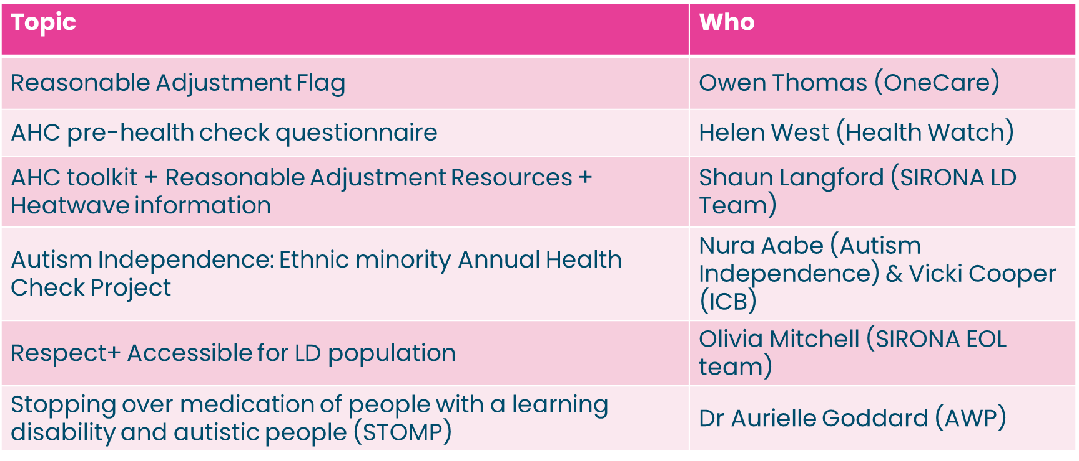
Agenda:

Slide 4

“Do you see me?” is about people with a learning disability being seen, heard and valued.
Learning Disability Week 2024 | Mencap

Slide 5
Reasonable Adjustments Digital Flag

Slide 6
Reasonable adjustments
Reasonable adjustments are small changes our services can make to help disabled people to access our services as easily as anybody else
The average life expectancy of people with learning disability compared to the general population is 14 years shorter for men and 18y shorter for women
People with learning disability from BAME communities die at a younger age –median age at death 34 years
42% death of people with a learning disability are avoidable, compared with 22% in the general population
Patients with learning disabilities have higher rate of physical and mental co-morbidities
Resources for Learning Disability Annual Health Checks and Health Action Plans (Remedy BNSSG ICB)

Slide 7
What is a reasonable adjustments digital flag?
Visible marker on a patient’s record
Identifies a person’s need for reasonable adjustments, and their underlying condition / significant impairments
Reasonable adjustments are a legal requirement under the Equality Act (2010).
These are the changes required by health and care services to make their service provision as accessible for people with disabilities as they are for everyone else.
These are anticipatory, with adjustments being made before a person presents for their care or treatment.
Supported by the RADF Information Standard published 12.09.23

Slide 8
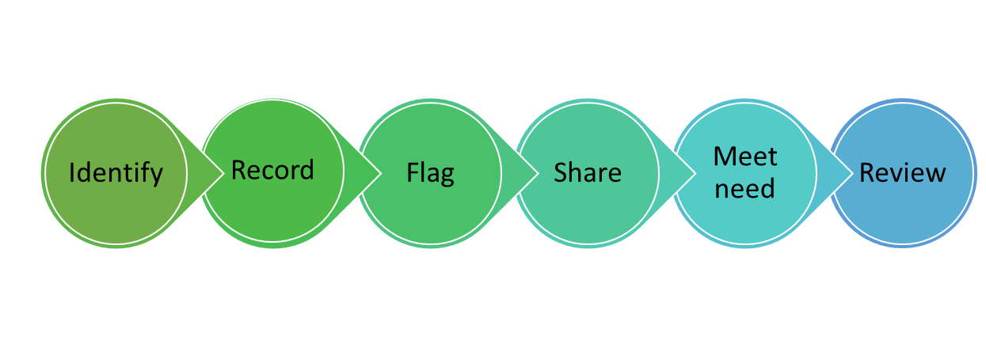

Phase One: (Local First)
Working with the patients we know, on IT systems we know, to increase WHAT we know
Six Simple Steps make Access to Care Fair
Identify – ASK at every contact (every contact counts)
Record – Using agreed CODES (digital) or paper
Flag – So it can be SEEN where YOU work
Share – in ALL communications you use
Meet – make your best EFFORT to meet the adjustment
Review - ASK if any changes need to be made
Six simple steps
  Identify those who have disability or impairment (NB NEED not WANT)
  Six step Reasonable Adjustment Process

Slide 9
What have we created?
In the absence of a national released RADF (such as within shared care record) and in order to meet the requirements of phase one, One Care, in collaboration with BNSSG ICB, Sirona, and the SW NHSE LDAP team, has undertaken the development of an EMIS solution tailored for BNSSG practices and Sirona.
This resource is a pop-up feature within EMIS Web, aimed at prompting clinicians to assess whether individuals with learning disabilities or autism require reasonable adjustments.
The pop-up enhances the documentation and review of such adjustments and works in tandem with the existing Ardens Reasonable Adjustments Recorded alert resources.

Slide 10
How the resources work – video demo
https://vimeo.com/944016331?share=copy

Slide 11
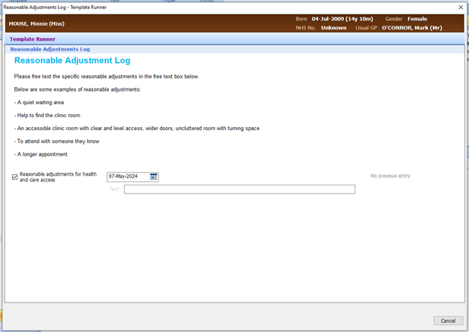
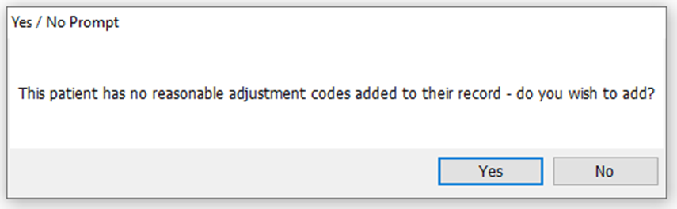
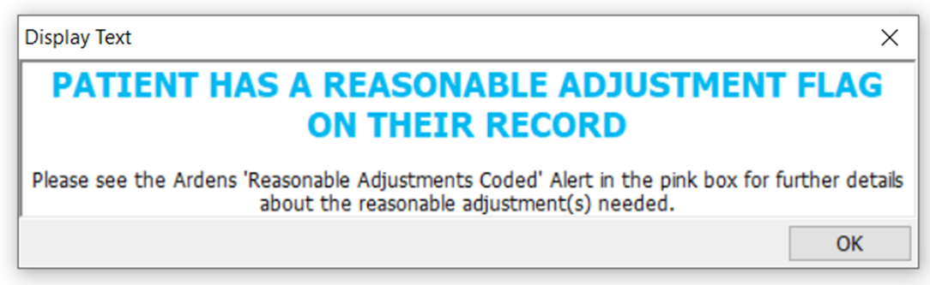
How the One Care resources work – screenshots
Consultation template screenshot:
Screenshot of prompt that is triggered when a patient has an LD or autism code on their record and NO reasonable adjustment code:
Screenshot of prompt that is triggered when a patient has an LD or autism code on their record and a reasonable adjustment code:
Example of how this is saved onto record:

Slide 12
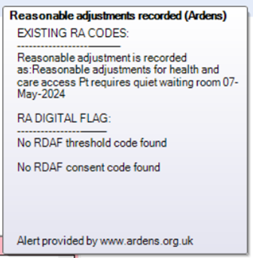
Ardens ‘Reasonable Adjustments Recorded’ Alert
This Ardens created protocol adds an alert to the patient’s pink box when a reasonable adjustment code has been added. This pop up shows what reasonable adjustment code has been added, what date the code was added and any free text associated with the code.

Slide 13
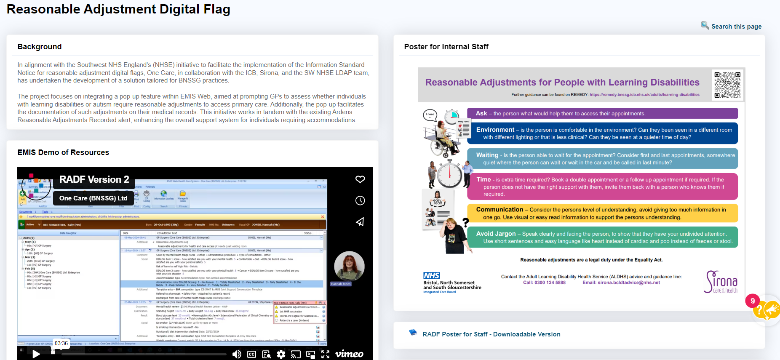
Teamnet resource page

Slide 14
Practice policy
NHSE requires a practice policy around the reasonable adjustment flag
We have created a sample practice policy you can adjust to your needs
Policy and other resources including patient information, staff information and practice policy here:
RADF teamnet resource page

Slide 16

What is the pre-health check questionnaire?
A checklist that can help a person with a learning disability and/or their carer make the most of their annual health check (AHC)
People with a learning disability
GPs and other health professionals
Parents/carers/family members and supporters of people with a learning disability
Who is the checklist for?

Slide 17
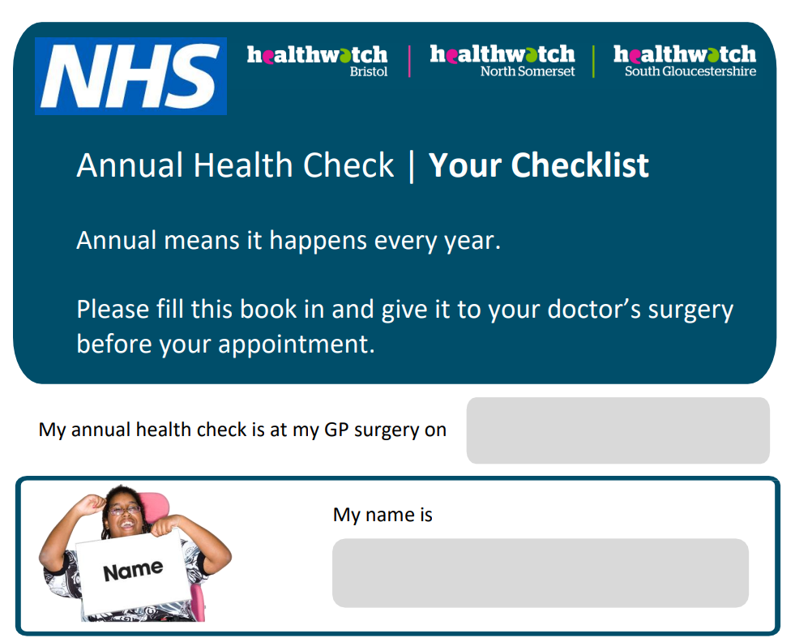

Slide 18
Updates to the checklist
The checklist was initially created by Healthwatch South Gloucestershire in 2020, and was co-produced with people with a learning disability.
Updates include:
Information about reasonable adjustments
A question about vaping
Questions that allow clearer answers e.g. about the type and amount of alcohol a person drinks
Addition of questions around bowel cancer screening, cervical screening, mammograms
The checklist has been updated to reflect current issues e.g.:
Smoking question updated to include vaping
What do you like to drink? Water; Tea; Coffee; Fizzy drinks; Juice; Squash; Other (space to write)

Slide 19
What impact has the checklist had?
In 2021/22, GP surgeries in BNSSG achieved the highest annual health check completion rates in the South West. 18% of surgeries completed 100% of their annual health checks.
In 2023, GP surgeries in BNSSG had an 83% completion rate of annual health checks – the highest rate in the South West. Plus - 98% of people have been leaving annual health checks with a health action plan, compared to 53% previously.
Notes:
You can use these slides to talk about YOUR Healthwatch branch specifically.

Slide 20
New Resources from the ALDHS
AHC Tool Kit
Reasonable Adjustments Posters
Heatwave Easy Read
Shaun Langford – Clinical Project Coordinator ALDHS

Slide 21

AHC Tool Kit
RCGP tool kit has been taken down.
Aim to support the completion of AHC’s.
Currently in draft – seeking testing and feedback.

Slide 22
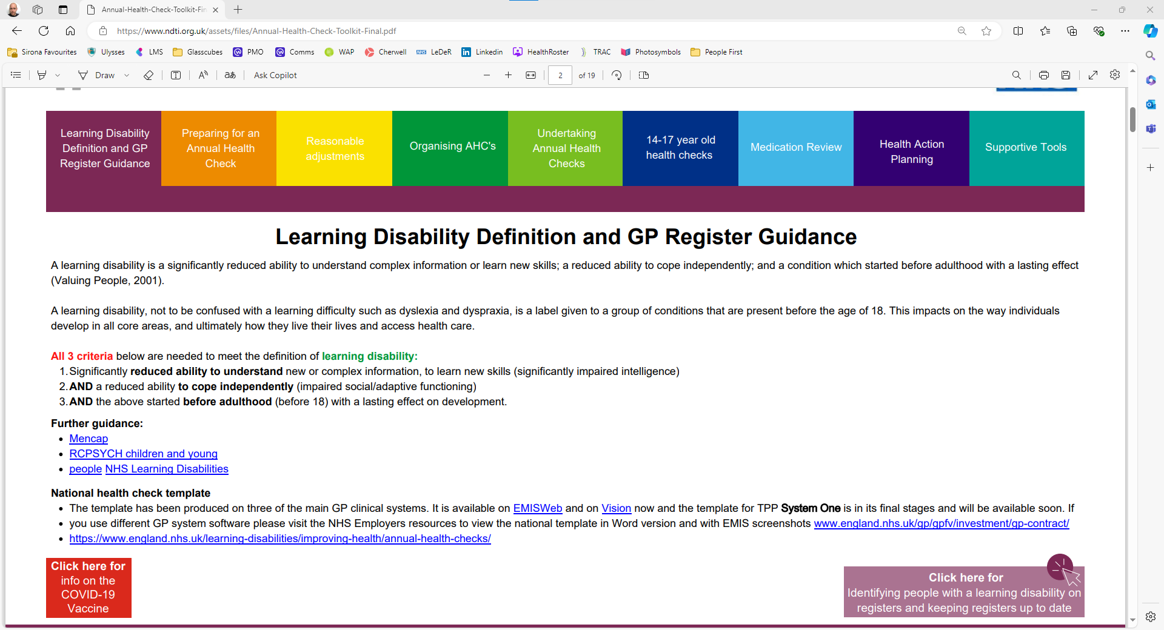
AHC Tool Kit
Annual-Health-Check-Toolkit-Final.pdf (ndti.org.uk)

Slide 23

AHC Tool Kit
Developed with Cornwall LD team to enable regional variations, pool resource.
Designed to be easier to navigate.
Practical application in mind, increased links and “how to” emphasis.
Not aimed at any one staff group.

Slide 24
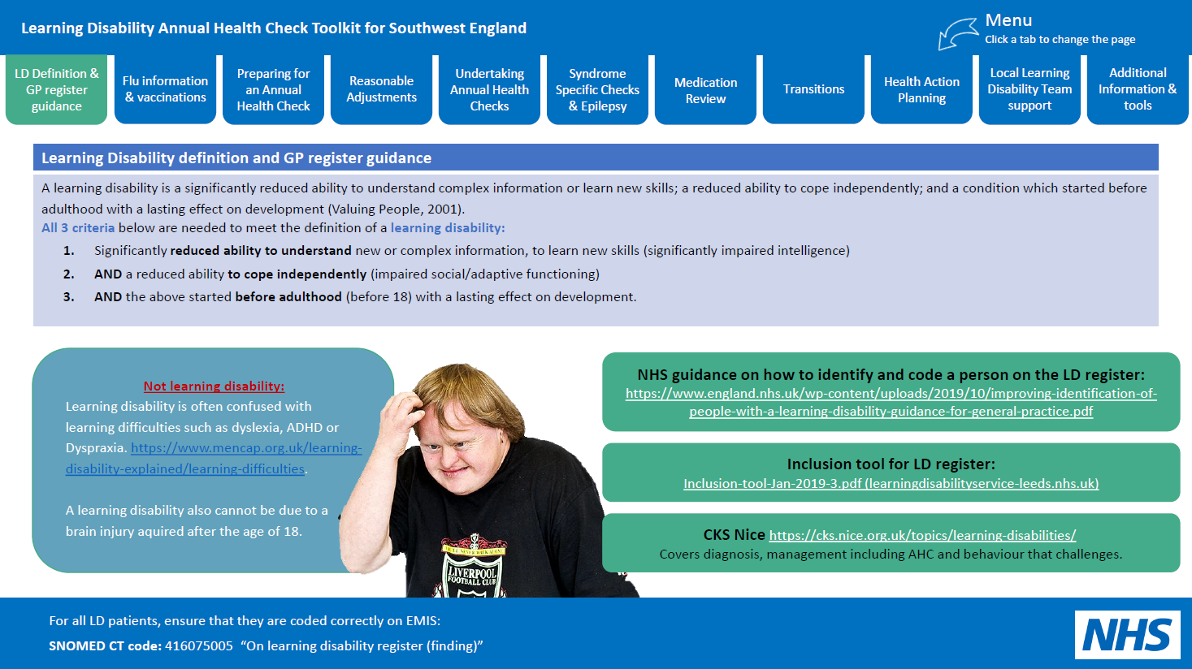
AHC Tool Kit

Slide 25
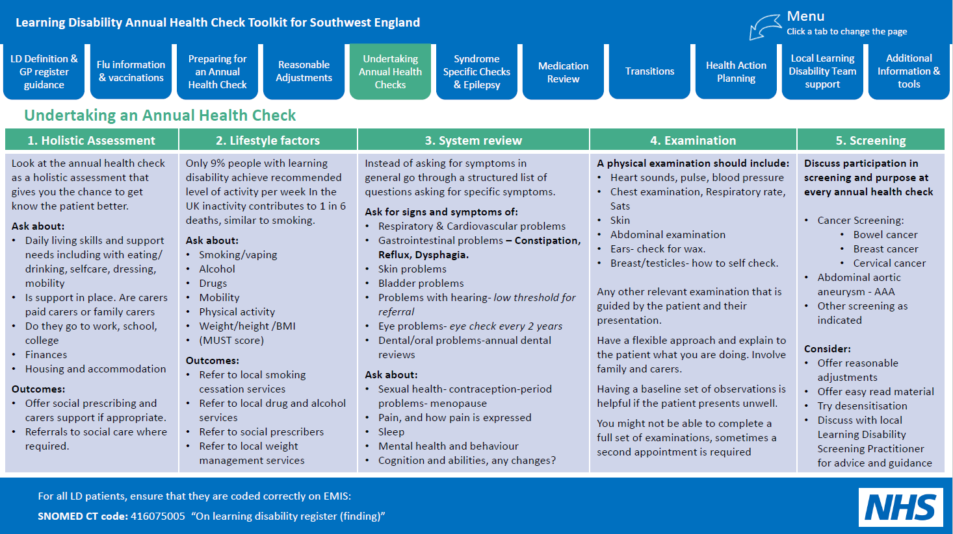
AHC Tool Kit

Slide 26
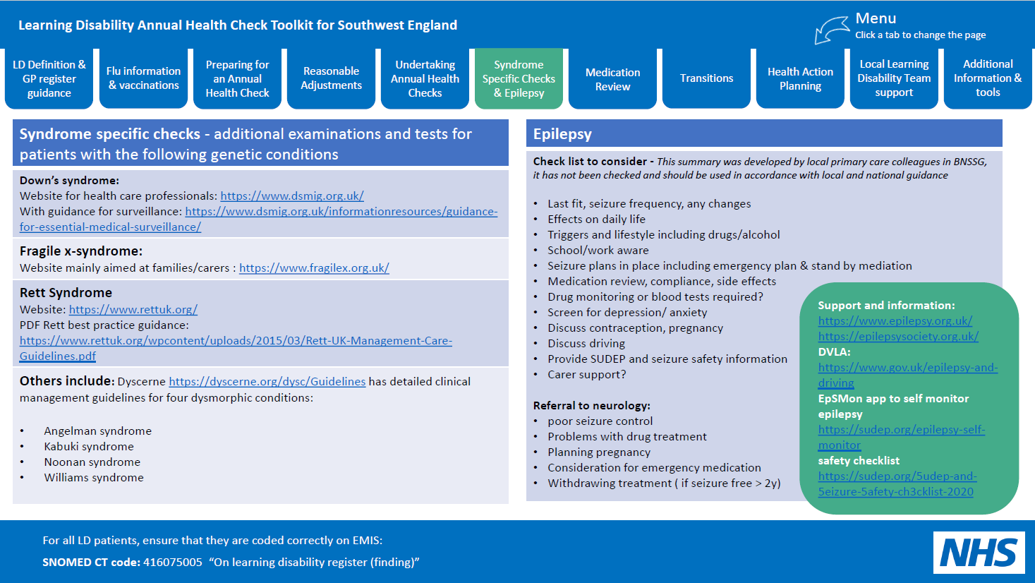
AHC Tool Kit

Slide 27
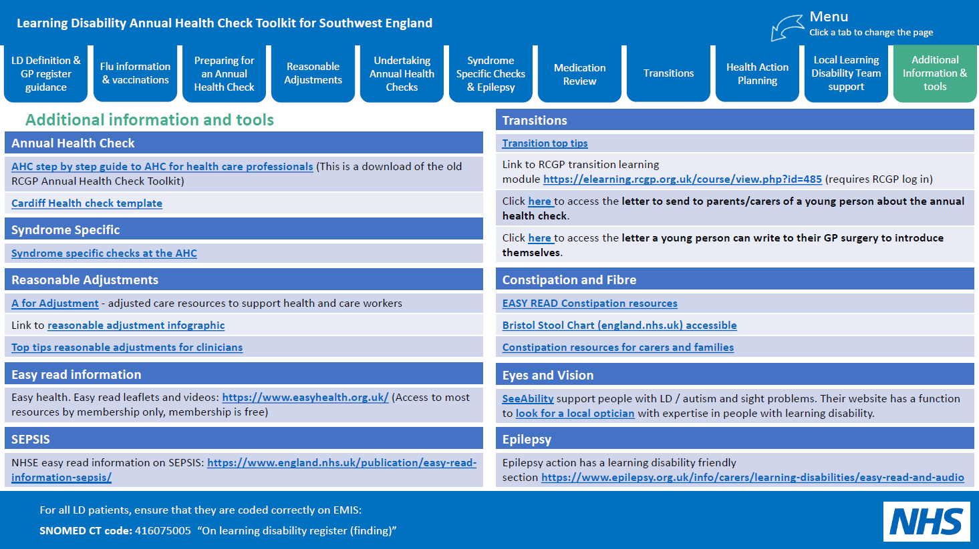
AHC Tool Kit

Slide 28
Trial support required
Email: Shaun Langford - s.langford@nhs.net

Slide 29
Reasonable Adjustments
Legal Duty under the equality act
“Go do them” approach
TEACH acronym to help remember:
  Time
  Environment
  Attitude
  Communication
  Help
  Making Reasonable Adjustments for People with Learning Disabilities (hertfordshire.gov.uk)
New Resources developed from SIRONA for primary care to aid staff and patients

Slide 30
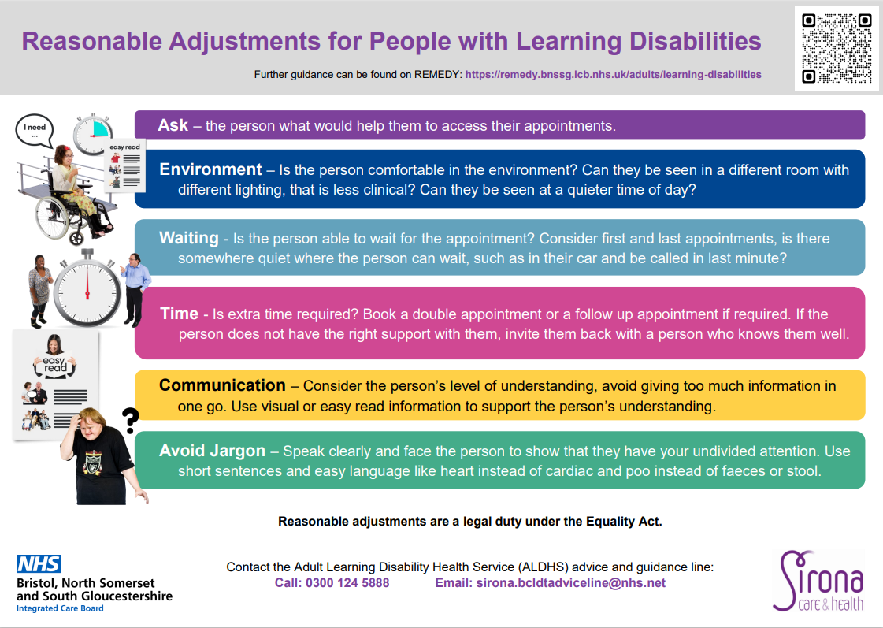

Slide 31
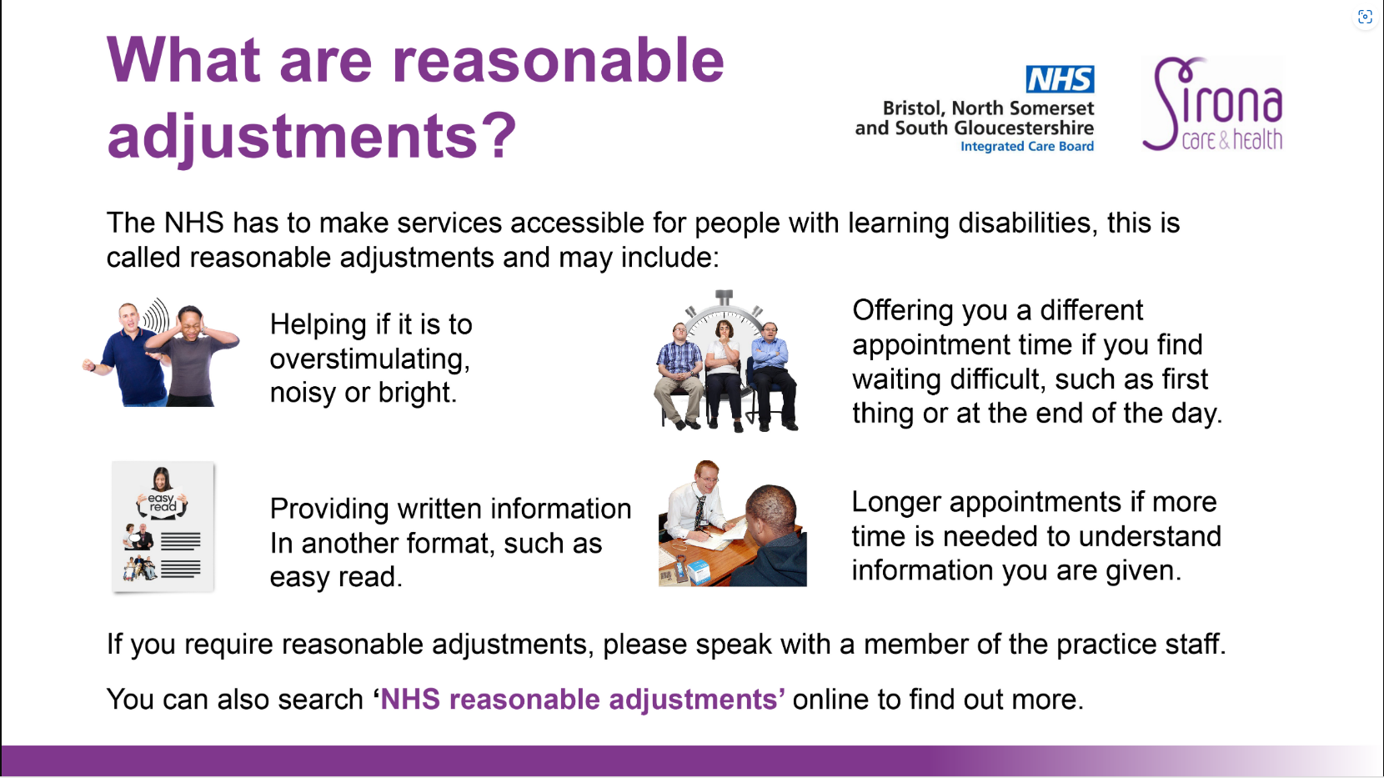

Slide 32
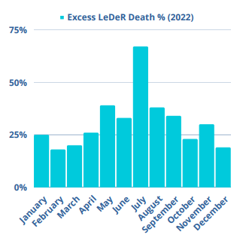
Heatwave
LeDeR – spike in deaths during heatwaves
  Learning from Lives and Deaths - people with a learning disability and autistic people (LeDeR) | King's College London (kcl.ac.uk)
National information available
  Main Heading (may go over several lines) (publishing.service.gov.uk)
Local sign posting, branding and joint media presentation

Slide 33

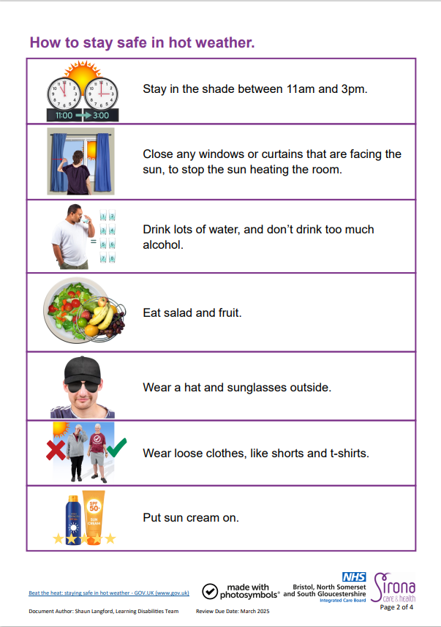
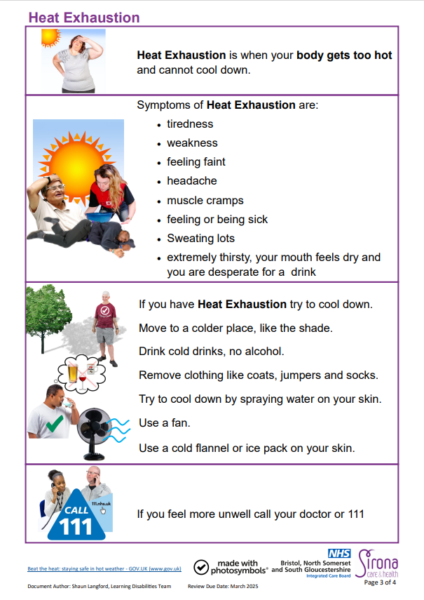
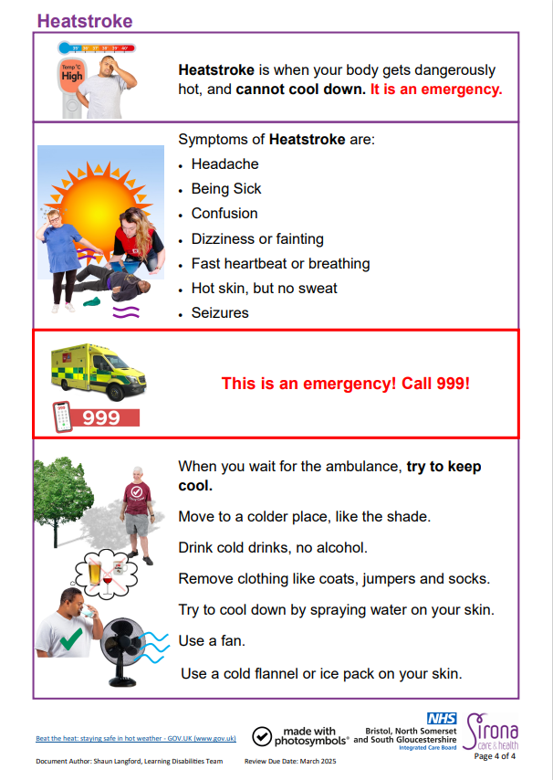
Heatwave easy read
Resources for Learning Disability Annual Health Checks and Health Action Plans (Remedy BNSSG ICB)

Slide 34


Heatwave Video
Coming to REMEDY soon

Slide 35


Slide 36

Autism Independence: Ethnic minority Annual Health Check Project

Slide 37
Background
A key finding from the LeDeR report found people with a learning disability from all ethnic minority groups died at a younger age in comparison to people of white ethnicity.
    2023/24 96% of LeDeR reviews within BNSSG where denominated as having a White British ethnicity.
    1 in 5 people are neurodiverse, 2.5% of the general population have a learning disability in the UK, this is similar to the number of people with asthma, but there is not a ten year wait for asthma diagnosis or support.
    Most individuals in this cohort do not want to engage with the system as there is still a stigma involved with learning disabilities and autism

Slide 38
Scope of the Project
This project took place over a six-month period and considered two main areas:
    Awareness raising: meeting carers and families and raise the profile of annual health checks.
    Supporting Carers: Autism Independence supported carers to access their GP, help them get their loved one onto the GP Learning Disability Register, book and where feasible attend an annual health check with the carer and the person.

Slide 39
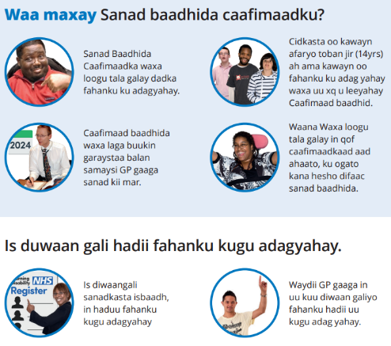
Awareness Raising
    Promotional leaflets were developed in Arabic, English, Polish, Somali and Urdu. These were in the form of digital posters, a banner stand as well easy read annual health check information leaflets.
    A video was also produced explaining the importance of the annual health check, who it is for and what to expect at an annual health check.
    Accessing Annual Health Checks - Autism Independence, Bristol (youtube.com)

Slide 40
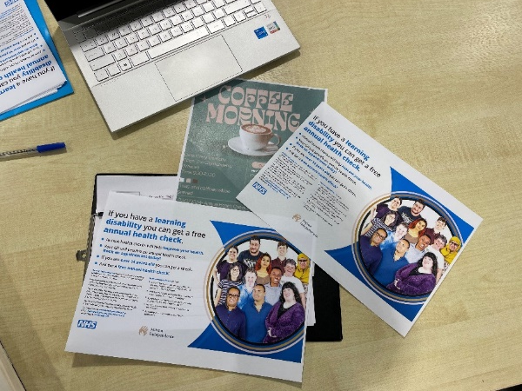
Awareness Raising
    Autism Independence know their communities and so visited:
    Schools,
    Hindu temples,
    Community Centre/Events,
    Mosques
    Shopping malls
    With the sole focus of raising awareness of annual health checks for carers and families who may be living with someone who has a learning disability.

Slide 41
Supporting Families
    Colleagues at Autism Independence provided practical support to families, carers and individuals to navigate the health system to ensure the person who has a learning disability was on their GPs learning disability register.
    Once on the register support if required was provided to attend the annual health check with the carer of person with a learning disability.
    It is important to note that the recruitment process for this project has been culturally sensitive, hence the success of what it has achieved. This meant that Autism Independence had a Somali and Bengali speaking team, as well as volunteers and directors from different ethnicities.

Slide 42
Findings
    Some people are already on the learning disability register and accessing AHC, once they are in the system in some cases this appeared to work well. It is important to note that this is purely anecdotal and further research into this would be needed.
    Carer feedback suggests for those already on the learning disability register some people do not receive a written health action plan and on occasion the actions following an annual health check have not been followed up.
    Qualitative data following the project suggests there are many barriers to people accessing annual health checks.
    Knowledge – there is a lack of knowledge from carers with individuals not always understanding the importance of the annual health check – thinking instead that it is just another GP appointment.
    Some carers/families struggle to accept the individuals learning disability diagnosis and in some communities a learning disability is stigmatised.

Slide 43


Findings
    Some ethnic minority families include multiple children but live in a small bedroom accommodation, for these families there are competing basic need priorities of housing and food. An annual health check when the person appears to be well may not be a priority compared to having a roof over your head and food on the table.
    When housing is not stable people are required to move house at times frequently consequently change GP as well. Leading to a delay in health records being transferred and potentially people missing appointments.
    This is not just a health issue.

Slide 44
Findings
    Carers who have childcare commitments who also support a person with a learning disability struggle to accommodate the competing priorities of both the child and individual to attend GP appointments.
    Many carers/families have mental health concerns because of the pressure they are facing and there is a fear services and support will be removed.
    Cultural Competence – some healthcare workers were not culturally competent and sent GP reminders in a written format that was not in an accessible language.
      Although many individuals speak English it does not mean they are able to articulate themselves or read English.
      Text message was a frequently used way to communicate – again this technology was a barrier so messages go unread.

Slide 45
Findings
      Navigating the healthcare system – it is difficult!
      Booking appointments varies by GP some taking electronic referrals others telephone bookings.
      Automated services are difficult to use especially for individuals who have a learning disability.
      Many healthcare workers were not often aware of the learning disability register or annual health check which deter individuals/carers if they feel resistance.
      Lack of understanding by healthcare workers that an individual does not need a formal learning disability diagnosis to be eligible for the learning disability register.

Slide 46
Considerations
Culturally equip healthcare professionals to make accessing annual health checks easier.
Ensure GP receptionists access Oliver McGowan Mandatory Training and are able to apply the learning from this to the day job
Provide cultural intelligence training for healthcare professionals
Maximising feedback and contribution by experts by experience and local communities to improve service delivery
GPs to ensure all communication is provided in an easy read format ensuring the context is relatable to a person from an ethnic minority background.
Add as a reasonable adjustments flag if someone has a learning disability of has communication issues.
Ensure AHC are easier for people to access. A suggestion is for GPs or Practice Nurses to provide AHCs in community settings. The current process is not culturally equipped to each all young people with a learning disability.
Improve AHC and health action plan awareness in families. Awareness must start earlier than just before the young person turns 14 years old, professionals from health, education and social care all need to be involved in providing a consistent message.

Slide 47
Considerations
Raise awareness with families that reasonable adjustments are a person’s legal right to ask for these.
Healthcare settings must create a safe space for people and parents of young people with additional needs.
The healthcare workforce must be culturally competent; this concerns the language used and a greater understanding of the stigmas faced by communities and barriers to using technology (e.g. text messages may not be used or read.)
This project must continue, and a health campaign needs to be created in schools, colleges, and health services. The model for this project can be used nationally, with us leading the way and changing the concept of ‘hard to reach’ communities to ‘everyone has a level access playing field’.
Healthcare workers must have a better understanding to distinguish between a learning disability, autism, learning difficulty, ADHD etc. This project found professionals at times conflate them. There is a need for all professionals to provide accurate information to families and carers to empower them to navigate the health system appropriately.
Ensure patient groups include people who have a learning disability from an ethnic minority.
Ensure the Autism Independence AHC posters are displayed in all GP’s waiting areas.

Slide 48
Considerations
Healthcare information must consistently be available in other languages. Feedback from the public have said there has been a lack of translated information leaflets.
Area-specific focus groups in different community settings across BNSSG to be set up to bring together families and GPs/ practice managers and receptionists. This is to help healthcare professionals to understand the complex issue faced by some communities in a safe space, away from healthcare settings.
Research into co-production and how the ICB could work with families to further the aims of this project.

Slide 49
Any Questions?

Slide 50

ReSPECT+
Accessible for LD Population
Olivia Mitchell, End of Life Clinical Lead

Slide 51
ReSPECT+
    Accessible by everyoA single cloud based care plan based on ReSPECT but also incorporating advance care planning and end of life care
    ne involved in the care of a patient in both health and social care, in order to guide decision-making, and delivery of patient-centred, coordinated care
    Facilitate the planning of personalised care, to ensure patients receive care that reflects their values, goals and preferences
    Alert health care professionals from any setting, that a patient has a serious health condition, has palliative care needs, or is approaching the end of their life, and will ensure they are prioritised appropriately
    Interoperable with clinical systems used across our providers
    Visible in our shared care record ‘Connecting Care’
    A patient portal should be available for our citizens in the future

Slide 52
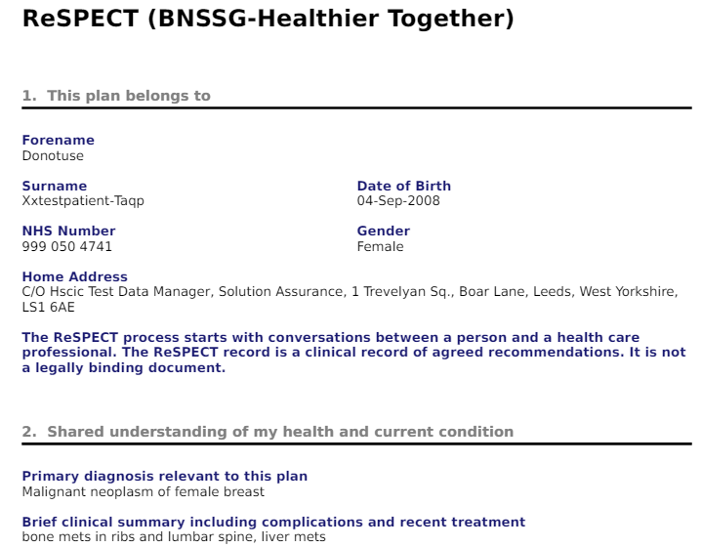

Example

Slide 53

ReSPECT+ & Health Inequalities
Specific sections asking about cognitive impairment and learning disabilities
Questions included specifically about reasonable adjustments
A detailed section has been incorporated to guide clinicians through assessing capacity and recording the outcome of this clearly
Developed with support from the national health inequalities team
In addition in the past cancer patients appear to have been disproportionately represented in advance care planning solutions (EPaCCS), the new solution prompts inclusion of those with any serious illness and moderate to severe frailty.

Slide 54
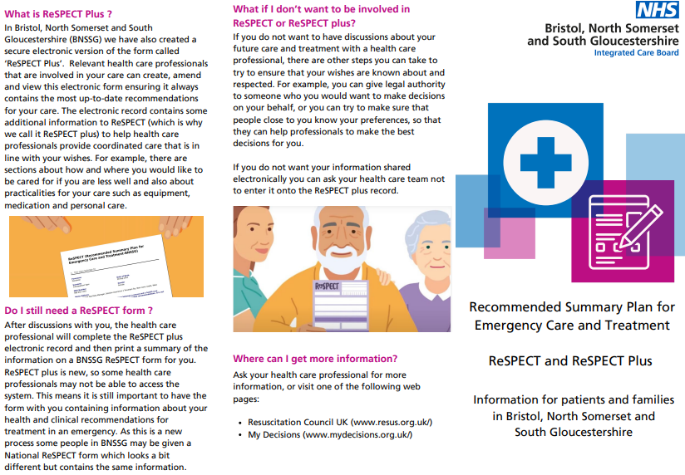
Leaflets
https://www.stpetershospice.org/media/nu1nedqk/respect-plus-patient-leaflet-oct-23.pdf
Notes:
Developed by EOL Collaborative group which is part of the ICB to support conversations. Available via SPH website.
Identified a need to develop an easy read version. Questions around funding for developing this… I volunteered to make a start.

Slide 55
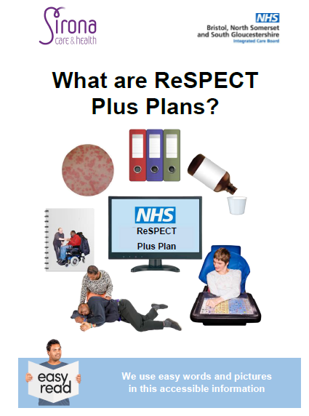

Easy Read Leaflet
Notes:
Worked collaboratively with Shaun from CLDT and Sirona’s Accessibility Officer Suzannah Cook with input from SPH Consultant, Dr Cornish.
Share PDF screen of leaflet

Slide 56


What Now?
Await software called Assist Pro and then have an official AIS compliant logo added to it
BNSSG Remedy Page
St Peter’s Hospice Website
Sirona Care & Health Website

Slide 57
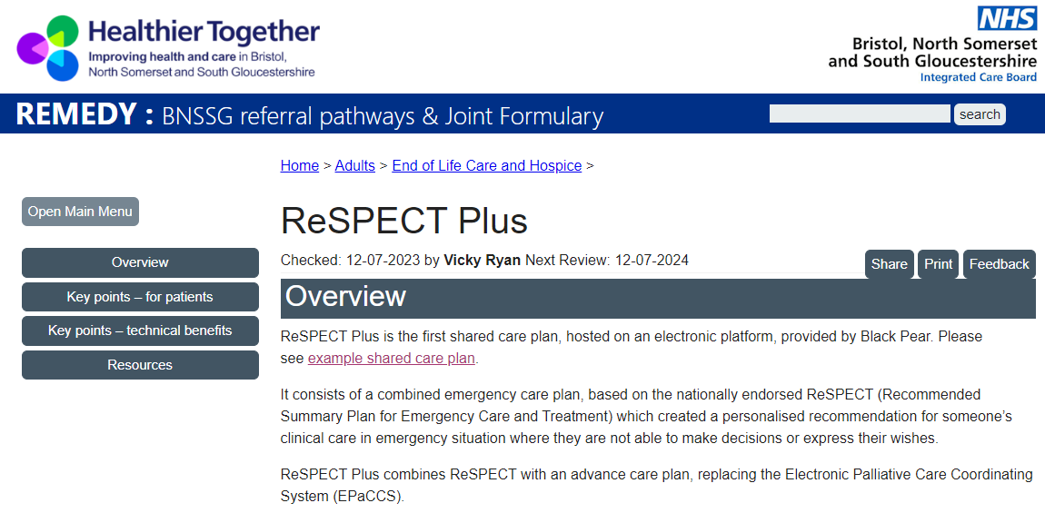
Further Information & Guidance
BNSSG Remedy: https://remedy.bnssg.icb.nhs.uk/adults/end-of-life-care-and-hospice/respect-plus/

Slide 58
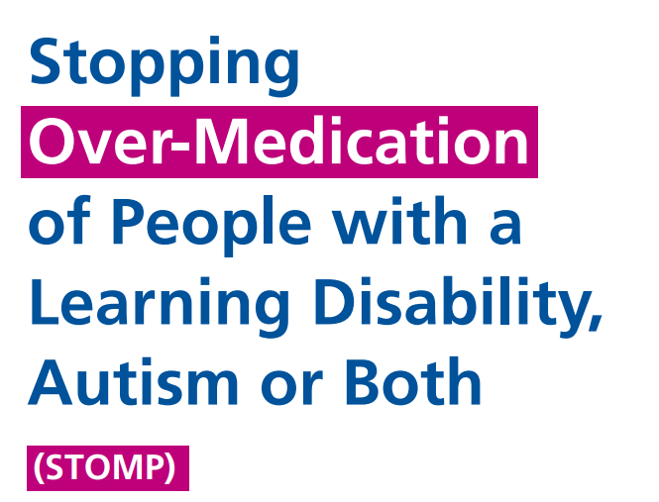

Slide 59
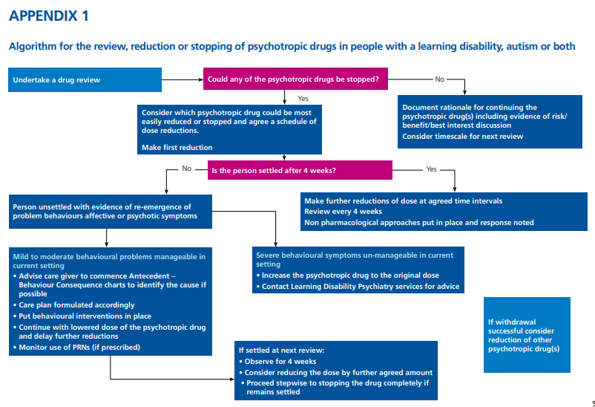

Slide 60
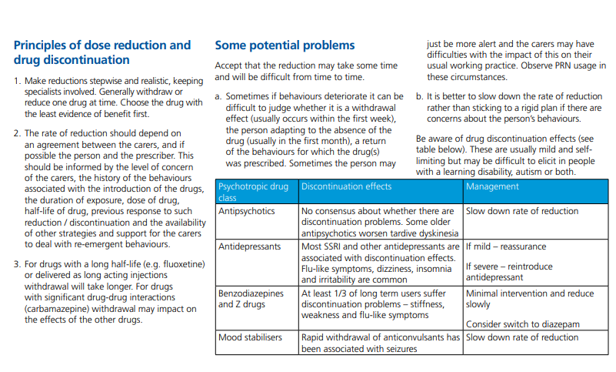

Slide 61
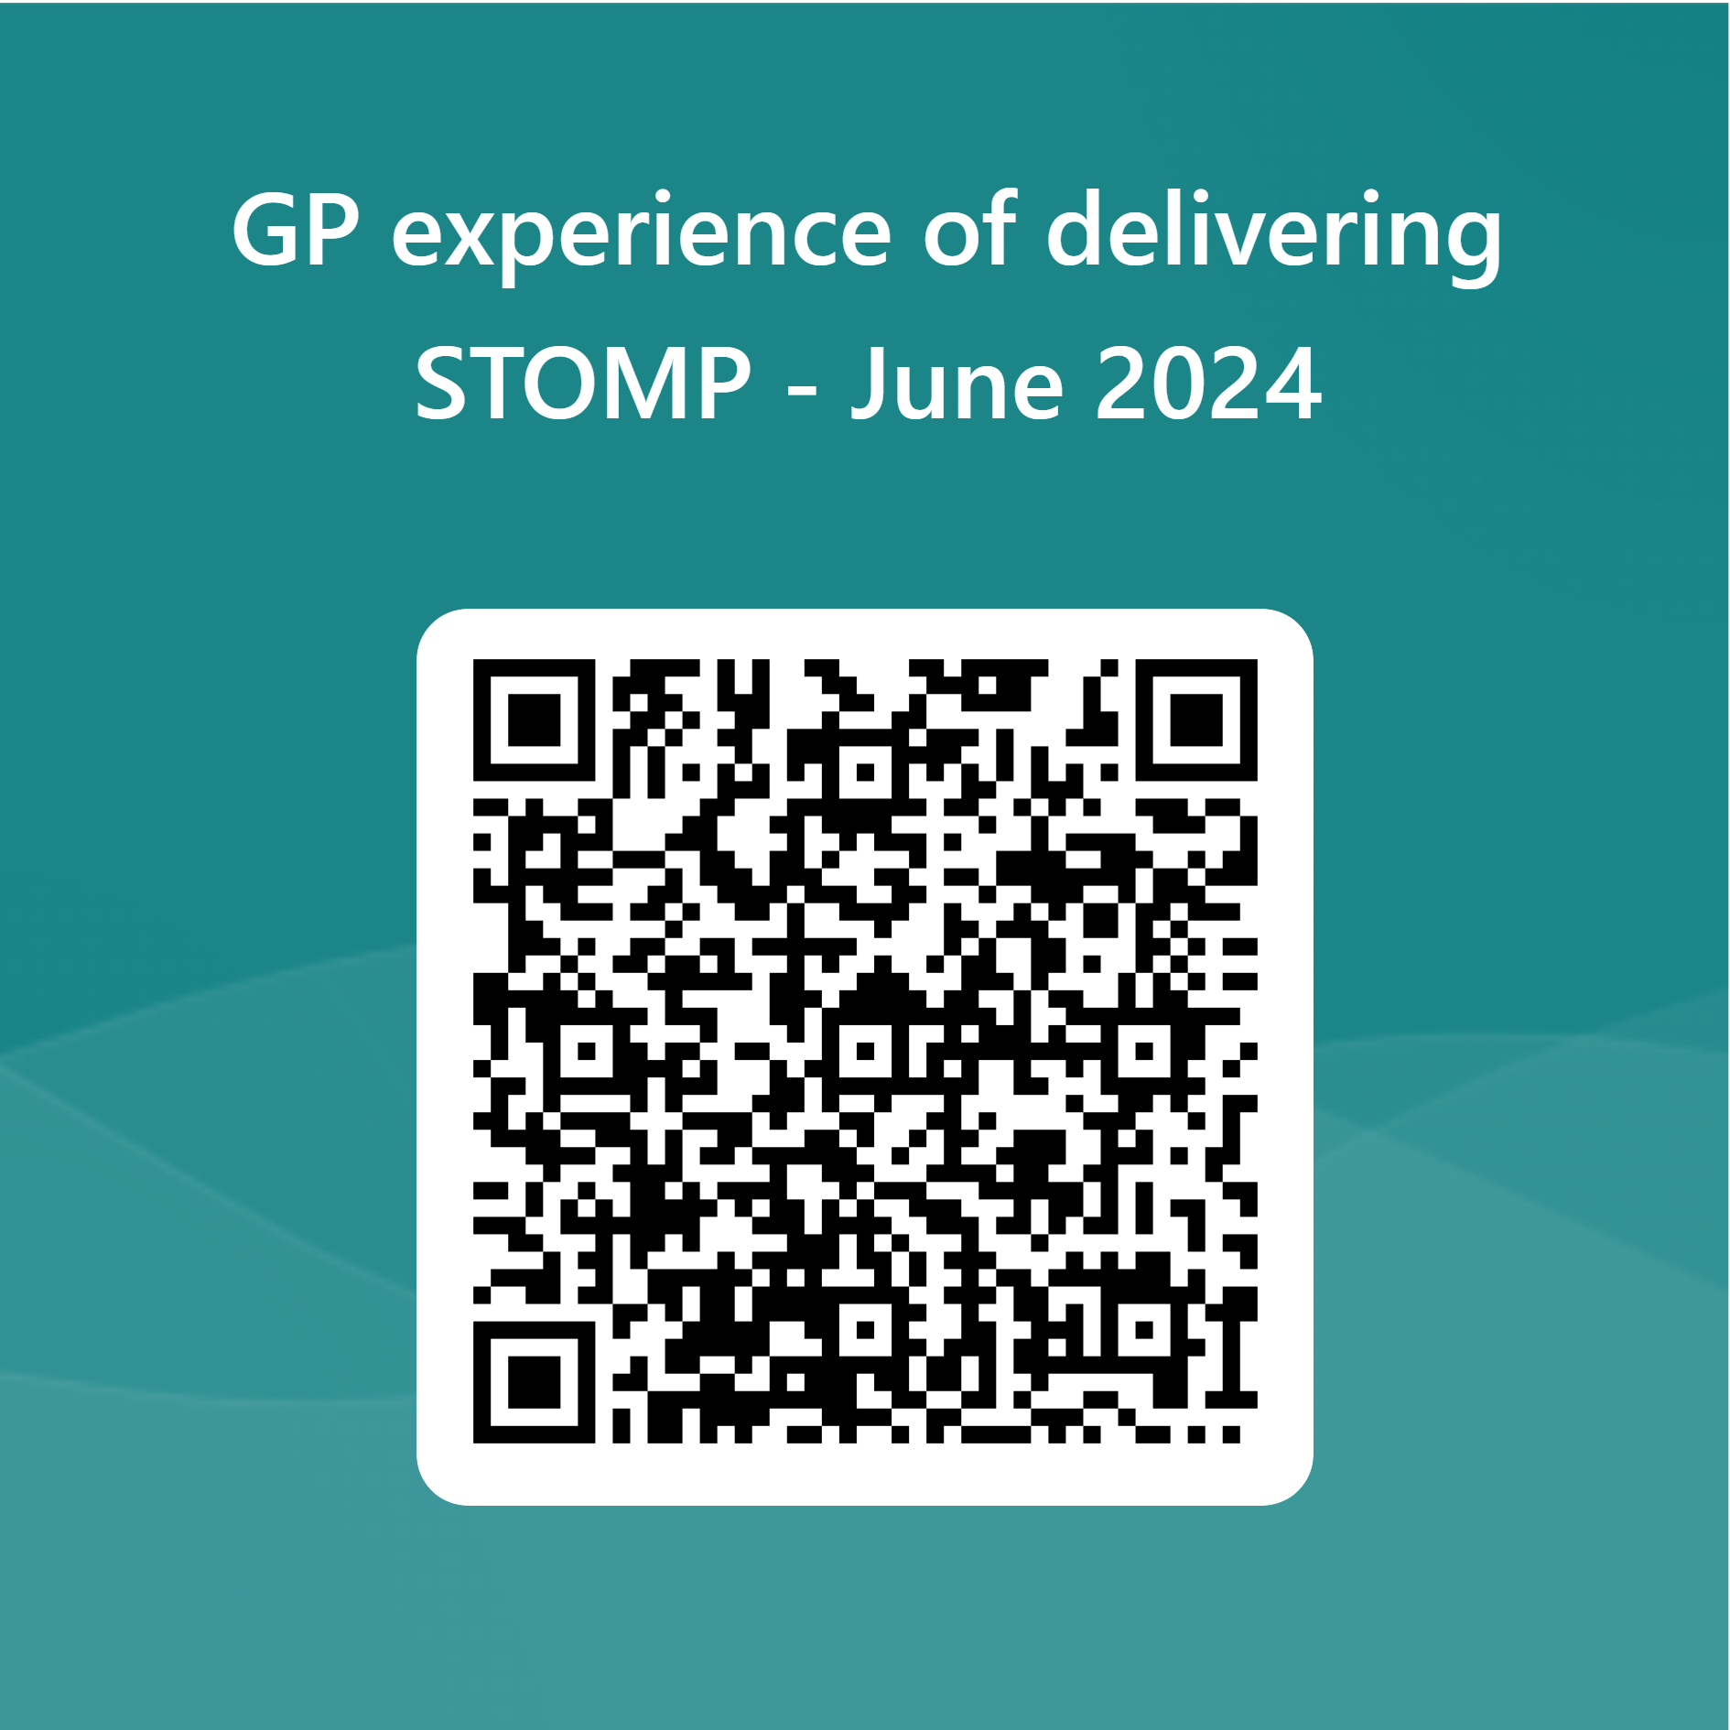

Slide 63
ALDHS advice and guidance line
Call: 0300 124 5888
Email: sirona.bcldtadviceline@nhs.net
Staffed by LD clinical MDT
Monday to Friday 09:00 – 16:00
General advice and support about LD
Sign posting to other relevant services
Resource sharing
Specific case discussions, referral criteria
Referrals (with consent)

Slide 64
What next
Quarterly webinars
Summer 2024 – Mental health and Challenging behaviour webinar
Oliver McGowen Training - https://www.hee.nhs.uk/our-work/learning-disability/current-projects/oliver-mcgowan-mandatory-training-learning-disability-autism
Join our mailing list for updates, email: sirona.ldchampions@nhs.net
To be involved with trial of AHC tool kit: s.langford@nhs.net

Slide 65

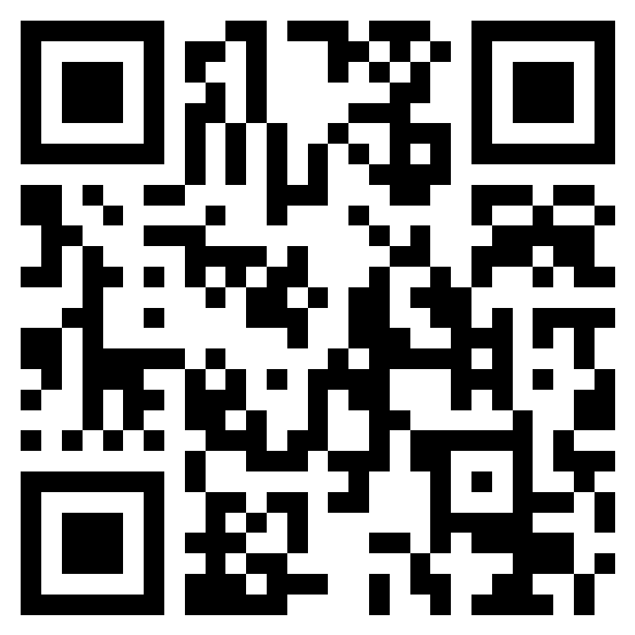
Thank you
Feedback
https://forms.office.com/e/DVcuVN2vNh

