Slide 1
Virtual and Hybrid Learning Faculty
(VHLF)
New Resources (March 2024)
Notes:
Standard title slide

Slide 2

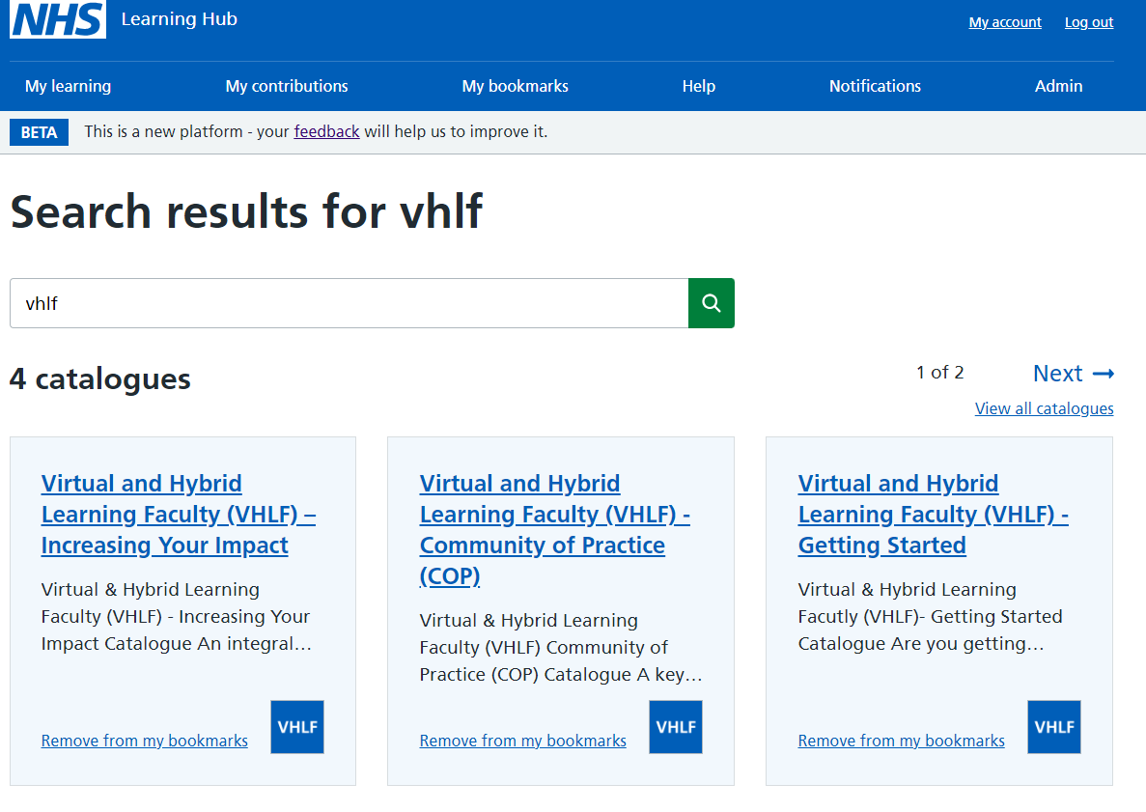


Accessing VHLF www.learninghub.nhs.uk
To access the VHLF, please visit the Learning Hub.
If you don’t have an account, please register for one. You can sign up through one of the following ways:
Using an e-learning for healthcare (elfh) username and password or
NHS OpenAthens user account details or
Creating a new account on the Learning Hub itself (please note T&Cs apply​)
All VHLF catalogues will appear here, please select the relevant catalogue ‘tile’ to view its content
Once signed in, search for ‘VHLF’, ‘Virtual’ or ‘Hybrid’ in the top search bar
Alternatively, all VHLF resources are listed below which you can filter/sort as needed

Slide 3
VHLF CPD Spring 2024 Resources
Simply The Best: The Art of Designing Impactful Education in the Digital Age | Data Is Everywhere: Leveraging It Is Everything | Self-Care In Education: Because you just can't pour from an empty cup | Here, There & Anywhere: A Hybrid Learning Journey | Systemic Leadership In Education: Changing The Paradigm
https://learninghub.nhs.uk/Resource/48930/Item | https://learninghub.nhs.uk/Resource/48936/Item | https://learninghub.nhs.uk/Resource/48950/Item | https://learninghub.nhs.uk/Resource/48955/Item | https://learninghub.nhs.uk/Resource/48956/Item
Impactful Learning: Digital Body Language & Camera Confidence | The Need For Change - It’s Not You, It’s The Data | The Inner Critic and the Inner Coach in Virtual Hybrid Learning | Psychological Safety In Education: Accelerating Innovation, Learning and Growth | The Art Of The Possible: Advanced Technology In Education | Artificial Intelligence (AI) In Health & Care Education
https://learninghub.nhs.uk/Resource/48929/Item | https://learninghub.nhs.uk/Resource/48931/Item | https://learninghub.nhs.uk/Resource/31064/Item | https://learninghub.nhs.uk/Resource/43717/Item | https://learninghub.nhs.uk/Resource/48957/Item | https://learninghub.nhs.uk/Resource/43704/Item
Notes:
Plain slide with subhead and bullets

