Slide 1




Multiprofessional Educator Learning Library
Collated by Clare Cambray,
Allied Health Professions Workforce fellow, 2024-2025,
AHP Team, Southwest NHSE, Workforce, Training & Education Directorate

Slide 2
Acknowledgements & Co-Produced with:
NHSE SW WT&E Jane Thurlow, Lead Associate Dean for Faculty Development & Learner support
NHSE SW WT&E Quality Team: Andy Gadsby
NHSE Nursing, midwifery & social care: Rachel Tims
NHSE SW AHP WT&E team: Carrie Biddle, Sarah Ashley-Maguire, Sarah Todd, Rachael Brandreth
The South West Educator workforce program leads
Multiprofessional Educators CoP Group
South West Safe Learning Environment Charter (SLEC) network members
SW AHP educator working group
Primary care educators / southwest multiprofessional modular program
This library is free to share, download, amend and add to your local / institution educator resources. Please acknowledge 'Clare Cambray, NHSE SW AHP workforce fellow' in any use.
Images of healthcare staff are downloaded from the Reframe image library Clinical Workforce - Reframe Image Library
Notes:
Plain slide with subhead and bullets

Slide 3
This Library Aligns to the following NHSE strategies:
NHSE Equality, diversity and Inclusion Improvement plan: NHS England » NHS equality, diversity, and inclusion improvement plan
Safe Learning environment charter: NHS England » Safe Learning Environment Charter – what good looks like
NHSE Educator workforce strategy: NHS England » Educator Workforce Strategy

Slide 4
Introduction
This library has been developed to support NHS & social care staff working across all sectors in meeting their professional & regulatory requirements for delivering high quality education within their workplace. Developing educator skills is a vital step in ensuring that learners at all levels are adequately supervised and receive effective training.
The training opportunities listed in this library are what is currently available and covers a range of self-directed, asynchronous, learning activities of varying duration / commitment. They are broadly appropriate for any health and social care profession to work through as a means of upskilling, developing and cementing skills as a clinical educator / supervisor.
Please note these are generic resources and not intended to replace profession-specific educator training from your educational organisations. There is a 'formal courses' section which covers profession-specific and academic / apprenticeship qualifications.
Notes:
Plain slide with subhead and bullets

Slide 5
Learning can be used as CPD mapping to the following areas:
Multi-professional development framework for educators (NB currently under revision): professional_development_framework_for_educators_2022.pdf
Academy of Medical Educators: Professional Standards for medical, dental and veterinary educators | Health Education North West
Allied Health Professions Educator Framework: Allied-Health-Professions-Educator-Framework.pdf & the AHP educator career framework interactive resource Catalogue
HCPC supervision standards:What our standards say | The HCPC
NMC Standards for student supervision: Standards for student supervision and assessment
Advanced Practice supervisors capabilities: Advanced Practice Supervisor Capabilities - Advanced Practice
NB other professions await development / publication of educator career frameworks
Notes:
Plain slide with subhead and bullets

Slide 6

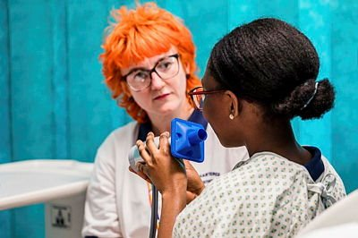
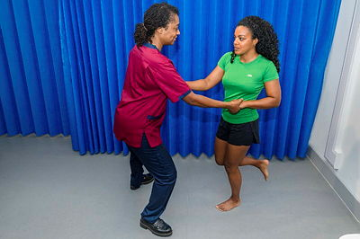
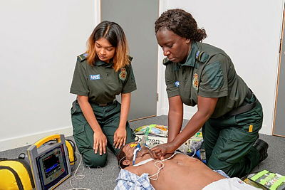

Learning Resource Themes:
Supervision
Communication Skills & Effective Feedback
Teaching Skills
(Including Digital)
Coaching & Mentoring Skills
Inclusive Learning
Structured Educator Programs
Free & Fee attached
Notes:
Sample icon grid slide – 6 icons (inc. alt text)

Slide 7
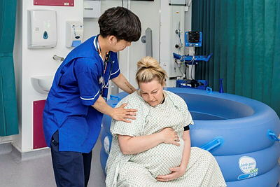
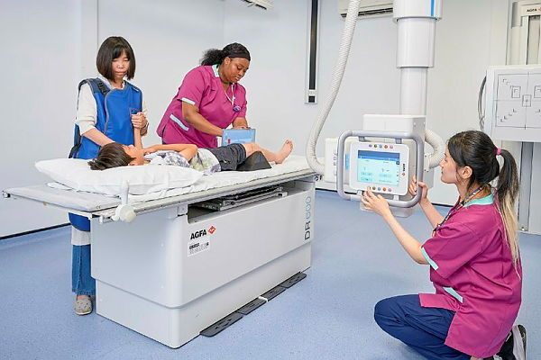
Supervision
Please note profession-specific educator training programs & CPD may also include this topic

Slide 8
Supervision
Supervision of learners: e-LfH . This e-learning module is part of the educator training resource program. You will need a free e-learning for health account to enroll. This learning takes 30 minutes.
A basic introduction to supervision across healthcare professions: NHSE elfh Hub You will need a free e-learning for health account to enroll onto this e-learning. This learning takes 1-3 hours depending on the number of reflective exercises undertaken.
Introduction to restorative supervision. This session describes the fundamentals of restorative supervision. This course is part of the safe learning environment practitioner program. Resource details. You will need a free NHS learning hub or open athens account to access this. This learning takes 60 minutes.
The benefits and outcomes of effective supervision. The benefits and outcomes of effective supervision | The HCPC. Guidance documents relevant to all HCPC registered clinicians
Notes:
Plain slide with subhead and bullets

Slide 9
Supervision
Multiprofessional supervision & assessment resources from the Centre for Advancing Practice. Supervision and assessment resources - Advanced Practice. This website contains guides and webinars on supervision in advanced practice and is essential reading for anyone supervising a trainee advanced practitioner.
Multiprofessional supervision resource: NHSE workforce training & education directorate London. Catalogue. This catalogue provides resources for both supervisors and supervisees (primarily aimed at those not on formal learning pathways). Designed as a multi-professional resource, it supports AHPs, nurses, midwives, pharmacists, healthcare scientists, and others. The contents are aligned with the CQC and Health and Social Care Act 2008 definitions of supervision: Managerial - focuses on performance management, accountability, and support to help employees meet objectives and adhere to policies. Clinical - Promotes reflection, learning, and skill development to enhance practice and ensure patient safety. Professional - Encourages reflection and adherence to standards for accountability and professional growth. Restorative - Supports resilience, stress management, and well-being through reflective practice.
Notes:
Plain slide with subhead and bullets

Slide 10

Communication Skills & Effective Feedback
Please note profession-specific educator training programs & CPD may also include this topic

Slide 11
Communication Skills & Effective Feedback
The Art of the Honest Conversation. The Art of Honest Conversation - elearning for healthcare. Most would agree that regular, constructive and developmental feedback to colleagues is a healthy part of the culture of any business or organisation. Yet sometimes feedback needs to be more direct especially when challenging undesirable or simply unacceptable behaviors of colleagues. You will need a free e-learning for health account to enroll onto this e-learning.
The Art of effective feedback. The art of effective feedback Online course | BMJ Learning .The ability to give and receive effective feedback on your work supports your leadership behaviours and ongoing professional development. Conveying feedback in a positive, supportive, and constructive manner will strengthen your working relationships and help you motivate your colleagues. This e-learning module will guide you through the process of giving and receiving feedback, and using the feedback you receive to enhance your career. You will need a login (via your organisation of open athens). This course is 1 hour.
Notes:
Plain slide with subhead and bullets

Slide 12
Communication Skills & Effective Feedback
Giving Feedback: Plymouth University’s Mentor Centre providing short e-learning and resources around mentoring others. Giving feedback - University of Plymouth. This introduces the importance of effective feedback and discusses some common models used in practice. Allow 30 minutes to complete.
Feedback: feedback – Bradford VTS. Bradford Vocational Training Scheme (VTS) is A well-known resource that GP Educational supervisors use. Applicable to multiple professional groups, especially if you are dealing with post-graduate learners.
How to give effective feedback: NHS leadership academy SW. This e-learning module is aimed at anyone who would like to be able to deliver feedback to other people in an effective way. It may be particularly useful for managers of individuals and teams who play a key role in developing others. You will need to register for an account to access this module: HELM LMS
Coaching conversations Part 3. Resource details. Part of the safe learning environment practitioner program. This module covers feedback models and the coaching model 'GROW'. You will need a free NHS learning hub or open athens account to access this. This learning takes 60 minutes.
Notes:
Plain slide with subhead and bullets

Slide 13
Communications Skills & effective feedback
Common models and approaches for the clinical educator to plan effective feedback encounters. Common models and approaches for the clinical educator to plan effective feedback encounters - PMC This academic review presents the 6 most common and accepted feedback models, including the Feedback Sandwich, the Pendleton Rules, the One-Minute Preceptor, the SET-GO model, the R2C2 (Rapport/Reaction/Content/Coach), and the ALOBA (Agenda Led Outcome-based Analysis) model. This paper describes their structure, strengths and weaknesses, requirements for educators and learners, and suitable feedback encounters for use for each model.
The Art of giving feedback. The Art of Giving Feedback. In this podcast, Therese Huston, a cognitive scientist at Seattle University who specializes in giving and receiving feedback, and Jessica Gomez, an elementary school principal whose job involves observing teachers and giving them feedback on their teaching, break down the art and science of giving effective feedback. They discuss what to prioritize when you give feedback, how to make sure your message is clear, and how to lay the groundwork for these difficult conversations. 34 minutes.

Slide 14
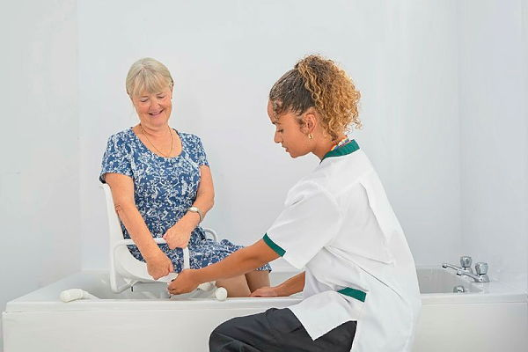
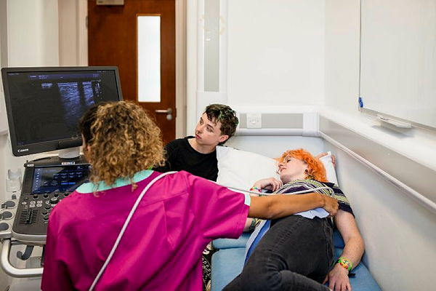
Teaching skills
Please note profession-specific educator training programs & CPD may also include this topic

Slide 15
Teaching Skills
Planning, Preparing & Structuring a small group teaching session. An academic review article. An introduction to basic educational theory around planning small group teaching sessions in healthcare professions. Planning, preparing and structuring a small group teaching session | BMC Medical Education | Full Text
Bradford Vocational Training Scheme (VTS) is A well-known resource that GP Educational supervisors use. Applicable to multiple professional groups, especially if you are dealing with post-graduate learners. Relevant sections include:
Aims, objectives and intended learning outcomes aims objectives ilo – Bradford VTS
The good (effective) teacher / teaching evidence for good teacher teaching – Bradford VTS
Teaching for beginners: teaching for beginners – Bradford VTS
Facilitating groups: facilitating groups – Bradford VTS
Games in teaching: games – Bradford VTS
Presentation & workshops: presentations and workshops – Bradford VTS
Problem based learning: problem based learning – Bradford VTS
Notes:
Plain slide with subhead and bullets

Slide 16
Teaching Skills (Digital)
Take Your Teaching online: Open University. Take your teaching online | OpenLearn - Open University . Commitment required: This free, online course runs over 8 weeks, requiring 3 hours per week. After studying this course, you should be able to:
Create, or support the creation of, digital material for different contexts and in a range of formats
Implement digital approaches to teaching and assessment
Use accessible and inclusive forms of communication, considering the needs of different users
Use collaborative digital environments and tools
Understand the educational value of different digital tools for teaching and learning
Share expertise through online communities of professional learning or practice
Use digital information to support decision making
Know where to find digital information sources and services relevant to your professional role.
Notes:
Plain slide with subhead and bullets

Slide 17
Teaching Skill (Digital)
The Digital Skills Assessment Tool (DSAT) is an online tool for NHS and social care workers.Digital Skills Assessment Tool | Digital Transformation .It helps assess digital skills by answering a set of questions, and then signposts to learning resources which will help improve existing skills. The assessment is delivered through our network of Digital Learning centers. To find your registered centre please visit the Digital Learning Solutions website. The tool has been developed by the NHS Digital Academy in partnership with the Technology Enhanced Learning (TEL) team.

Slide 18
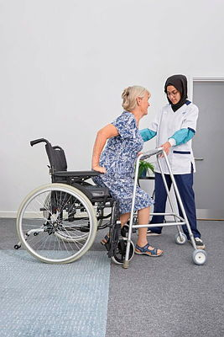
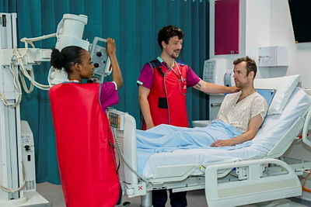
Coaching & Mentoring Skills
Please note profession-specific educator training programs & CPD may also include this topic

Slide 19
Coaching & Mentoring Resources
Coaching Conversations - Part 1 Includes topics on The Coaching Spectrum, Skill and Will, Active Listening: Resource details
Coaching Conversations – Part 2. Resource details
Mentoring: NHS Elect. Whether you want to start mentoring someone or you're already an experienced mentor looking to refresh your understanding - this e-learning course will guide you through the fundamentals of mentoring. Our experienced coaching faculty will give you the tools you need to get started through this four hour online course. (NB only some South West organizations have signed up for staff to receive free access)
Coaching skills: NHS Leadership academy You will need to register for an account to access this module: HELM LMS. Learning objectives:
Explain the principles of coaching and how these differ from other forms of support and development,
Recognise how coaching benefits you, your staff and your organization
Apply the skills, knowledge and behaviours of an effective coach to your own coaching work
Make use of a recommended framework to engage staff in coaching conversations
Find opportunities to use coaching in a work context.
Notes:
Plain slide with subhead and bullets

Slide 20
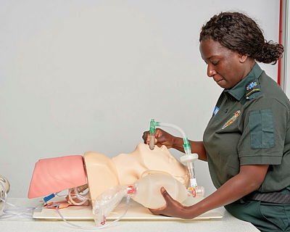

Inclusive Learning
Please note profession-specific educator training programs & CPD may also include this topic

Slide 21
Inclusive Learning
The Inclusive Training within Practice (ITP) project offers learning resources to support inclusive practice in healthcare with specific focus on healthcare practice education for Nursing, Midwifery and AHP. This multi-system multidisciplinary project is funded by NHS England South West and led by University of the West of England, Bristol (UWE). There are a range of resources on the learning hub platform. You will need an open athens or free learning hub account to access:Catalogue
The Allyship Learning Library Catalogue. This library contains varied learning material from podcasts, webpage links, e-learning, videos, toolkits, academic articles and books on antiracism and allyship. You will need an open athens or free learning hub account to access:
Unconscious Bias, NHS Leadership academy You will need to register for an account to access this module: HELM LMS. It is suitable for anyone who is starting to explore this topic or as a refresher for people who already know a little about the basics. Learning objectives:
What is Inclusion and Exclusion?
What is Equality and Diversity?
Cognitive Bandwidth
Unconscious Bias & Motivation
Notes:
Plain slide with subhead and bullets

Slide 22
Inclusive Learning
BMJ Online e-learning Inclusion essentials. Inclusion essentials Online course | BMJ Learning. This course is for any healthcare professional. It takes 1 hour. You will need an open athens password . After completing this course you should: Know what we mean by equality, diversity and inclusion, The basic provisions of the Equality Act 2010, The key benefits of having an inclusive working environment, How to provide a genuinely inclusive and accessible customer experience, How to put diversity and equality policy into practice.
Staff & Student Healthcare Initiative for Neurodiversity and inclusion (SSHINE) Neurodiversity training modules. SSHINE Neurodiversity Module – Florence Nightingale Foundation. 5 online modules with video & audio clips and resources for further reading. Each module is approx 10-15 minutes. Useful resources including C.H.L.O.E forms and 1 page profiles for students and supervisors to use prior to placement start.
Neurodiversity Webinar from the Academy of medical educators AoME Insights Embracing Neurodiversity in our Healthcare Educators 29 March 2023. Neurodiverse individuals bring the lived experience and an understanding and empathy to neurodiverse patients. By sharing strengths including focus, attention to detail and pattern recognition; all traits that are valuable in medicine and recognized as such in many other work environments. The Academy of Medical Educators embraced the opportunity to bring together experts in the field of neurodiversity in medical education to support our educators and learners. 1 hour 57 minutes.
Notes:
Plain slide with subhead and bullets

Slide 23
Inclusive Learning
Inclusive teaching and practice guidance:Resource details The guidance is aimed at practice educators (working in healthcare) and academics in practice and program teams (working in education). It offers core themes which are divided into units and examine the importance and promotion of facilitating meaningful dialogue on race and racism, exploration of strategies for setting up the classroom as a practicing safe space, and lastly delves into the importance of reflective practice as practitioners.
Ethnicity, Race & Culture: Ethnicity Race Culture – Bradford VTS Bradford Vocational Training Scheme (VTS) is A well-known resource that GP Educational supervisors use. Applicable to multiple professional groups, especially if you are dealing with post-graduate learners. Ethnicity Race Culture – Bradford VTS
Key tips to providing a psychologically safe learning environment (article). Open athens password will give you full access. Key tips to providing a psychologically safe learning environment in the clinical setting | BMC Medical Education | Full Text
Supporting Educational Excellence in Diversity (SEED): faculty development and allyship. Open access article. Supporting Educational Excellence in Diversity (SEED): faculty development and allyship | BMC Medical Education | Full Text

Slide 24
Inclusive Learning
Council of Deans Report (2023) Anti.racism.in_.ahp_.education.report.pdf
Racial Inclusivity in Practice Education. Resource details. This resource is intended for those wishing to facilitate training sessions with practice educator colleagues to improve racial inclusivity in practice education. It was developed by and for physiotherapy practice education, so is more specific to a physiotherapy context but also has relevance to other health and social care professionals. The workshop is intended to run for 2.5 hours and guidance is given in the resource for the timing of each activity and prompt questions to consider.
DiverseEd# UK based training organization aimed at school educators but all content relevant to healthcare educators Inclusive Allyship Toolkit | Diverse Educators
DiverseLearners: Information to support neurodiverse learners and educators. DiverseLearners | Twitter, Instagram, Facebook, TikTok | Linktree
The REFRAME image library. Diverse Images for Healthcare Uniting people, healthcare professionals and providers, our mission was to create a diverse image library that represents the communities we serve. We focused on capturing a comprehensive range of medical photographs of people from different backgrounds and creating more inclusive healthcare images of staff. Free to download images for use in clinical education.
Notes:
Plain slide with subhead and bullets

Slide 25
Inclusive Learning: Sexual Safety
Understanding sexual misconduct in the workplace. Understanding sexual misconduct in the workplace - elearning for healthcare You will need a free e-learning for health account to enroll onto this e-learning. This e-learning resource provides people working in the NHS with the knowledge and skills to recognize and respond to sexual misconduct. If someone tells you they have experienced sexual harassment or assault it can be hard to know what to say or do. Completing this training will support learners to have sensitive conversations with colleagues about sexual misconduct. The program supports the sexual safety in healthcare charter for organizations to:
Identify and recognize the types of sexual misconduct in the workplace.
Understand the impacts that trauma can have and how this can affect people who have experienced sexual misconduct.
Understand how to have a trauma-informed conversation and know how to support someone if they tell you that they have experienced sexual misconduct.
Maintain confidentiality, respect professional boundaries, and look after your own wellbeing when someone tells you about sexual misconduct they have experienced.
Equality and human rights commission guidance on preventing sexual harassment in the workplace: Employer 8-step guide: Preventing sexual harassment at work | EHRC
Notes:
Plain slide with subhead and bullets

Slide 26
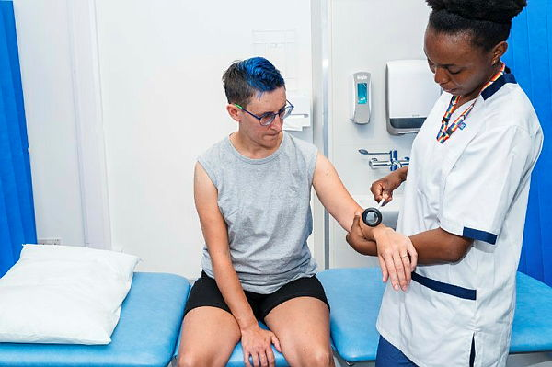
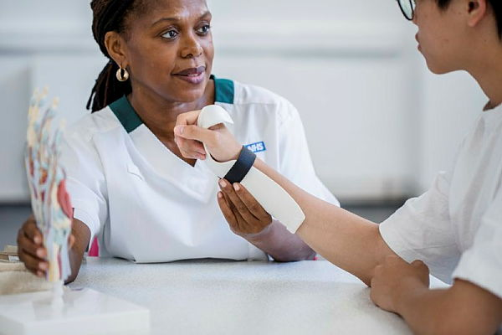
Structured Educator Programs
(Free Online & Fee Attached)
Please note profession-specific educator training programs & CPD may also include this topic

Slide 27
Structured Educator Programs (Free)
Supporting AHP students: Catalogue. The aim of this e-learning course is to provide non-registered AHP assistants and support staff with training to develop their understanding of student education and to develop their skills in supporting students and educators within their teams. NB you will need to sign up for a free learning hub account to access this training.
Safe Learning Environment Practitioner Course: Catalogue The safe learning environment practitioner training program. The SLEP program aim is to empower individuals and organisations to create positive, safe learning experiences for apprentices and students. Safe Learning Environment Practitioners will meet with learners in their workplaces to undertake SLEP conversations underpinned by concepts of restorative supervisions.
Foundations in Medical Education. Foundations in Medical Education | Health Professions Education | University of Bristol This short free online program is suited to those who are in a teaching role and have not had any formal training but may not yet want to commit to the full Health Professions Education qualification.
National School of Healthcare science: Healthcare Science Training Resources. A library of resources to support trainers, assessors, and trainees in healthcare science work-based training. Catalogue
Notes:
Plain slide with subhead and bullets

Slide 28
Structured Educator Programs (Free)
Pharmacy Educational Supervisor Training. e-learning program developed for pharmacy practice and educational supervisors working across different sectors of practice, including community pharmacy and health and justice pharmacy settings. Pharmacy Educational Supervisor Training - elearning for healthcare. You will need a free e-learning for health account to enroll onto this e-learning.
Module 1, Core skills: Introductory level topics, relevant to practice and educational supervision. This module is recommended for all as an introductory module or to refresh existing knowledge. Module 1 takes 2 hours
Module 2, Enhanced skills: A deeper learning approach to topics relevant to practice and educational supervision, providing context for specific programmes. This module is recommended for practice and educational supervisors involved in specific regulated pharmacy training programs and those who wish to develop their skills further. Module 2 takes 3 hours
Notes:
Plain slide with subhead and bullets

Slide 29
Structured Educator Programs (Free)
The AHP Practice Educator Training Program has been designed for any healthcare professional involved in student placements . Catalogue. NB you will need to sign up for a free learning hub account to access this training. The aim of this training program is to:
Make widely available an accessible multi-unit e-learning program available to all AHPs, AHP practice educators and healthcare professionals
Offer a standard level of practice educator training and development across all the AHPs
Improve the knowledge and skills of practice educators to support quality learning environment
Increase practice educators’ confidence to supervise learners and support them to develop in their role as an educator
Improve students’ experience of practice-based learning
Improve understanding of the importance of practice-based learning and value the role of the practice educator
Encourage more AHPs to become practice educators
Notes:
Plain slide with subhead and bullets

Slide 30
Structured Educator Programs (Free)
UWE CPD course for supporting healthcare learners in clinical practice. Supporting Students in Practice - Professional/Short course - UWE Bristol: Courses This free course, also known by the course code UZYKFP-0-3, replaces the AHP Practice Learning and Student Support, and Nursing Facilitated Learning and Assessment in Practice (FLAP).This course is suitable for all healthcare professionals supporting students in practice. You will be directed to profession-specific material during the course. This course is self-directed learning which you can undertake over a period of three to four months. There are no specific times or dates to undertake this course but you must apply for a specific start date to be enrolled.
The educator training resources program. NHSE elfh Hub.You will need a free e-learning for health account to enroll onto this e-learning. There are 5 courses featuring more than 50 sessions around the topics of: supervision, teaching methods, assessment and the learning environment. NHSE elfh Hub. Each module takes 30-40 minutes. This multiprofessional resource is applicable to those who are teaching, supervising, and assessing different professional learners in practice. This program maps with this multiprofessional educational framework: professional_development_framework_for_educators_2022.pdf (NB this has portfolio paperwork in the appendix section that can be used to evidence education-based CPD)

Slide 31
Structured Educator Programs (Fee Attached)
Apprenticeship course: Level 5 Learning and Skills Teacher Apprenticeship for Practice Education Facilitators and Clinical Educators in NHS England SW Region: Case Study: Enhancing teaching standards in the NHS – Varsity Training. This project introduces the Level 5 Learning and Skills Teacher Apprenticeship as an accredited and national recognized apprenticeship qualification for Practice Education Facilitators (PEFs) and Educators. The apprenticeship route equips health and social care clinical educators with advanced teaching skills, empowering them to deliver high-quality education and support across the workforce. This innovative new apprenticeship model approach enables greater choice for health and social care professionals to be upskilled in education practice, via the employers apprenticeship levy fund.
Multiprofessional Supervision of Learners in primary care: Formal training program route for the Southwest. Supervision of GP Training - Severn Primary Care. The Multi-professional Modular Supervisor Course allows supervisors to train to supervise a range of learners in an efficient way. It is comprised of 2 generic (half day, on-line) modules that introduce the core aspects of supervising any learner. This is for all new supervisors who don’t have appropriate prior supervision qualifications. There are then craft-specific modules that focus on the specifics of supervising different learners (e.g. GP trainee, First Contact Practitioner, Advanced Practitioner).
Notes:
Plain slide with subhead and bullets

Slide 32
Structured Educator Programs (Fee Attached)
PgCert Clinical Education University of Exeter (60 credits at Level 7) Clinical Education MSc | Postgraduate Taught | University of Exeter
PgCert Clinical Education University of Plymouth (60 credits at level 7)PgCert Clinical Education - University of Plymouth
PgCert Health Professions Education University of Bristol (60 credits at Level 7) Unit and programme catalogues | University of Bristol 3 Masters level modules: MEEDM0037 Theory and Practice of Learning and Teaching 20 credits, MEEDM0025 Clinical Based Education 20 credits MEEDM0026 Assessment and Evaluation 20 credits, These can be completed over one or two years.
Teaching, coaching and supervision University of Gloucestershire (15 credits at level 7) University of Gloucestershire Teaching, coaching and supervision for advanced clinical practice CPS [Level 7] - University of Gloucestershire.
Notes:
Plain slide with subhead and bullets

Slide 33
Structured Educator Programs (fee attached)
Principles of Supervision, Mentoring and Coaching University of Exeter (15 credits at Level 7) HPDM142 | University of Exeter. On successfully completing the module you will be able to: 1. Critically reflect on principles for effective feedback in the clinical/healthcare context, with reference to relevant education-focused literature; 2. Demonstrate an understanding of feedback models, techniques and associated opportunities and challenges in the workplace; 3. Evaluate your own ability to transfer skills associated with mentoring/supervision/coaching to your own area of professional practice, identifying priorities/action points for further development
Clinical Educator National Development Program: NHS Elect - Clinical Educator National Development Programme This program is aimed at those working in a role with protected time for education delivery, coordination or strategy, within the health and care setting. We aim to develop skills, confidence and community, to enable more effective and efficient education provision for the health and care workforce. Over 6 months, participants will attend 8 3-hour online modules. This program is available to staff at both member and non-member organisations. The cost for staff at member organisations is £995 per participant or 4 tokens, subject to approval from your account lead. Staff at non-member organisations can join this program for £1,200 per person. Clinical Educator National Development Program

Slide 34


Reflection on Learning
Please note profession-specific educator training programs & CPD may also include this topic

Slide 35
Reflection:
HCPC guidance on reflective practice: Reflective practice | The HCPC
NMC guidance on reflective practice: Written reflective accounts - The Nursing and Midwifery Council & reflective-practice-guidance.pdf & supporting-information-for-reflection-in-nursing-and-midwifery-practice.pdf
GMC guidance on reflection: Reflective practice learning materials - GMC
RPS reflection guide: Reflective Practice PF making the most Jan19.pdf
National School of Healthcare Science Training Resources. Module 2. Developing and facilitating reflective practice. Resource details

